Slide 1
Equality, Diversity & Inclusion (EDI) & Health inequalities overview
KCVD (Cardiovascular) & KCRS (Respiratory) Community services @ Knowsley PLACE
(EDS) Equality delivery system review
8th January 2026

Slide 2
Contents
Introductions
Our Pledge
What our service offers
Overview of the Community Cardiovascular and Respiratory Services
A current update on the action plan and current care delivery of the Domains set in the EDS framework
How can we improve?
Case studies and patient experience feedback
How can we link better with Neighbourhoods and support the MDTs?
Questions?

Slide 3
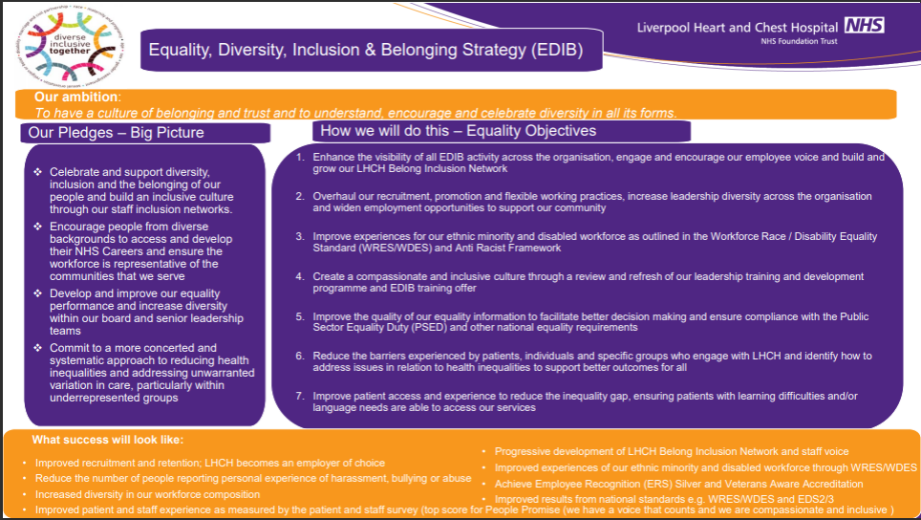

Slide 4
Overview of service delivery
Cardiovascular and Respiratory services in Knowsley demonstrate strong assurance against the NHS Equality Delivery System (EDS). The model of care is built around population need, with a clear commitment to reducing health inequalities, improving accessibility, and delivering high‑quality, evidence‑based care. The overarching focus is on wrapping care around the patient, ensuring personalised, equitable support for all.
Knowsley faces some of the highest levels of deprivation nationally, with significant health inequalities, high rates of long‑term disability, and a substantial burden of chronic respiratory and cardiovascular disease. As a result, services such as KCRS and KCVD are intentionally designed to prioritise equity, inclusion, and proactive support for vulnerable groups.

Slide 5
Key Strengths
PRSAS‑accredited Pulmonary Rehabilitation - the first service in the C&CM ICB to achieve this status, demonstrating excellence in pulmonary rehabilitation
NACR Gold Standard Cardiac Rehabilitation, reflecting outstanding performance and adherence to national best practice
NICE‑aligned heart failure and long‑term condition management, with strong integration of palliative care to support patients across the full care pathway
A robust hospital avoidance model, evidenced by strong delivery and achievement of KPIs within the Rapid Response and HOS‑AR service elements
Leadership, Workforce, and Governance
The service contract is ahead of the curve, consistently performing at Achieving to Excelling levels across all EDS domains. This is underpinned by:
Strong, visible leadership
A clear commitment to patient voice and choice
High levels of workforce engagement
A proactive approach to staff health and wellbeing
Robust clinical governance ensuring safety, quality, and continuous improvement

Slide 6
Overview of service delivery
KCRS and KCVD provide inclusive, equitable care by bringing specialist support directly to people
who face the greatest barriers - including those who are frail, isolated, digitally excluded, or living in
deprivation. We use:
Accessible communication
Culturally sensitive practice
Person‑centred assessment
These approaches reduce health inequalities and help keep patients safe and supported at home.

Slide 7
Equality, Diversity & Fairness
Our community‑based model actively promotes equity and is designed to:
Tailor care to individual needs
Ensure fairness and accessibility
Reach patients who might otherwise fall through the gaps
Provide proactive, wrap‑around support for vulnerable groups
This ensures equality, diversity, and inclusion are embedded in everyday practice.

Slide 8
Local Population Need
Knowsley is one of the most socially and economically deprived boroughs in England, characterised by:
High levels of disability
Poor housing conditions
Significant and persistent health inequalities
This context shapes our service design and reinforces the need for equitable, targeted, community‑focused care.

Slide 9
Local Facts
Knowsley has a population of roughly 162,500 (mid-2024 estimate)
Ethnically, Knowsley is less diverse than many parts of England: ~95.3% identify as White, with small minorities: ~1.6% Asian or Asian British, ~0.8% Black or Black British, ~1.7% Mixed or Multiple ethnic groups, ~0.6% other
Around 23.6% of the population (≈ 35,000 people) report a long-term disability (i.e. a substantial and long-term adverse effect on day-to-day activities) per 2021 Census
Many households are affected by deprivation: in 2021 census data, about 59.2% of households in Knowsley were deprived in at least one dimension (e.g. poor health, overcrowding, lack of central heating) - the highest proportion of any local authority in England/Wales
Within Knowsley there are stark inequalities: life expectancy for men is significantly lower than England average (for 2018/20: ~76.3 for men, ~79.8 for women)
The gap between life expectancy in the most versus least deprived areas is large: for men up to ~10 - 12 years difference; similar for women
Respiratory disease (along with cancer and cardiovascular disease) is among the top causes of premature mortality under age 75 in Knowsley
A notable proportion of the population are “unpaid carers” and there is a relatively high rate of disability and chronic illness

Slide 10
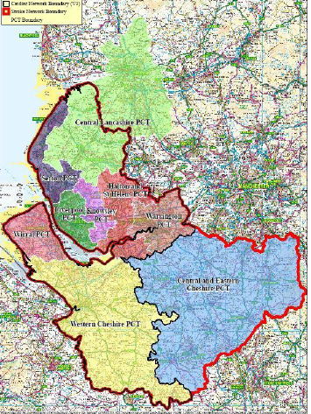
Transforming community services
Transforming Community Services
Services redesigned - Underpinned by robust patient & public engagement
Aim: Increase clinical quality,
decrease fragmentation and inequality,
move services closer to home,
reduce hospital activity &
increase productivity
Result: High quality clinical service
delivered in places people wanted,
at the times they wanted &
in the way they wanted
Patients treated in the manner they wish to be
treated
Knowsley

Slide 11

Who are we ?
Multidisciplinary Team
Multi-cultural well led MDT Team
Specialist Nurses
Nurse & Physio consultant
Matrons/Lead nurses
Advanced Clinical Practitioners
Pharmacist
Physiotherapists/SALT/OT
Exercise Physiologists
Cardiology & Respiratory consultants
Diagnostic Team
Admin Hub
Therapy assistants
HCA
Volunteers
Services delivered across the Borough of Knowsley
Community Primary Care Resource Centres
St Chads
Bluebell
Whiston
Halewood
North Huyton
Manor Farm
Nursing Homes - patients' homes - virtually (capturing hard to reach areas)
Community Leisure Centres
Huyton
Kirkby
Halewood
Prescot
Whiston Town Hall
Stockbridge

Slide 12
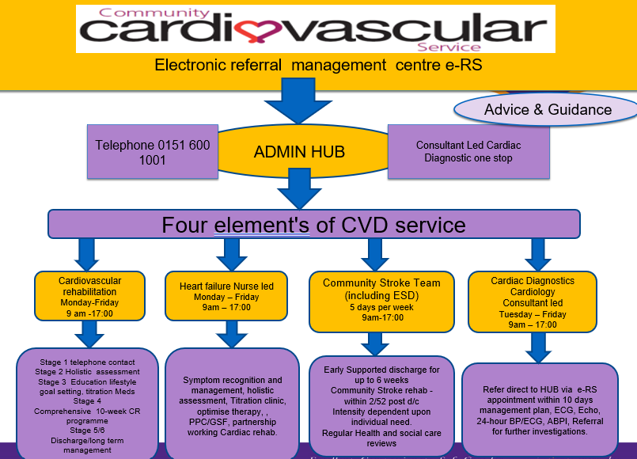

Slide 13
Muscular Dystrophy & Learning Disability
Challenge: Excluded from physical education due to her condition.
Intervention:
  Home visits after school to avoid disruption.
  Specialist nurses provided education and support to teachers.
  Exercise physiologist prescribed tailored exercise plan with clear “do’s and don’ts.”
Outcome: SF was fully included in PE sessions, her school day remained uninterrupted, and teachers felt supported.
Inclusive Case Studies
Key Themes Across Cases
Inclusion: Ensuring patients are not excluded from education, exercise, or decision‑making.
Adaptation: Delivering care in environments where patients feel safe (home, school, hospital with preparation).
Collaboration: Multi-disciplinary teamwork across nursing, physiotherapy, speech & language, social work, and specialist services.
Respect: Honouring patient preferences, capacity, and individuality- even when labelled “difficult.”
Empowerment: Tools like health passports and tailored exercise programmes foster independence and participation.
These stories beautifully demonstrate how compassionate, flexible, and collaborative approaches can dismantle barriers and ensure that patients with complex needs receive care that is dignified, inclusive, and aligned with their values
Severe Agoraphobia
Challenge: Unable to leave home but required diagnostic ECG.
Intervention:
  Arranged home ECG to establish diagnosis.
  Enabled creation of a clinical management plan without forcing exposure to distressing situations.
Outcome: BH received essential care in the safety of her home, ensuring equitable access to diagnostics.
Learning disability and Cultural Challenges
Challenge: threat of homelessness following family breakdown and cultural issues. Difficulty in accessing support due to literacy barriers. Severe heart failure with ICD
Intervention:
  Heart failure team liaised council team with regards to diagnosis and ICD device to facilitate move to safe accommodation
  Heart failure staff book phlebotomy appointments for patient as unable to access online booking system given literacy status
  Referral to learning disabilities service for formal diagnosis and support moving forward
  Medication supplied in compliance aids
  Telephone calls by admin prior to patient to confirm appointments
Outcome: Safe relocation whilst awaiting permanent residence. Compliance with therapies and stable symptoms
COPD, Heart Failure & CVD
Challenge: Distressed by abrupt prognosis disclosure; perceived as “difficult” due to smoking and non‑compliance.
Intervention:
Worked closely with her and her supportive family to honour her wishes.
Established a Preferred Priorities of Care plan.
Managed care primarily through the heart failure service, with minimal district nurse involvement as per her preference.
Collaborated with COPD colleagues and counsellor for additional support.
Outcome: Pt died peacefully at home, in line with her wishes, with dignity and family involvement respected.

Slide 14


Cardiac Rehabilitation Service
Multi-disciplinary approach
The key aim of the cardiac rehabilitation programme is to deliver core components to not only improve physical health and quality of life but also to equip and support people to develop the necessary skills to successfully self-manage. This is delivered with a biopsychosocial evidence-based approach, which is culturally appropriate and sensitive to each individuals needs and preferences. Patients can choose to attend at local venues, at home, digitally or a combination
The service delivers CR to the broadest range of conditions amongst all CR providers across the UK.
Support service users with special requirements
Patients are provided with additional time for assessments when needed. Information leaflets and resources are available in a range of languages. This includes a recent project with the CR network to develop educational videos and make these accessible in additional languages.
Patients with additional needs receive an individual, holistic assessment and a personalised rehabilitation plan. A team member or “buddy” is usually allocated to support the person with any ongoing needs. Where appropriate, patients can be offered one‑to‑one rehabilitation if group sessions are not suitable
Access to the service is adaptable to service user requirements
Patient appointments and clinics are adapted to meet individual needs, with flexibility to involve family members, carers, and other health professionals when required. One example involves a patient with a hypoxic brain injury who had previously been declined by another service due to their cardiac condition and complex care needs. Through a joint MDT approach with the neuro‑specialist team, the patient was able to attend the community‑based service for a day visit - supported by neuro specialists and family members - while still an inpatient at the neuro hospital. This personalised planning and collaborative MDT working ensured that cardiac rehabilitation remained accessible, demonstrating a level of adaptability and commitment beyond what other services were able to offer.

Slide 15
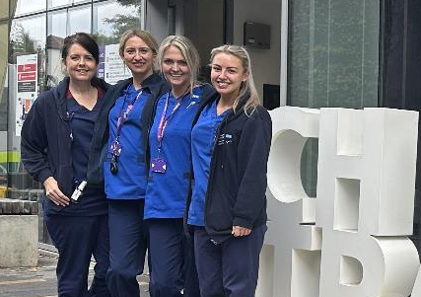



Heart Failure Service
Nurse-led Heart Failure Service
  3.6 WTE nurses
  Non-medical prescribers from April 25
  Advanced skills
Referral criteria with Consultant Cardiologist support – based national guidelines
Referrals accepted from community CVD service, secondary, tertiary and primary care with established diagnosis
Referrals accepted from patients known previously to service if discharged in last 6-12 months
Patients are identified at the time of referral, when possible, or language barriers that may impact consultation and service provision. Service utilises interpreter services to aid communication and consultation. Longer consultation times or last appointments of the clinic are requested to avoid unnecessary pressure. Evidenced by the usage of interpreter services.
Holistic approach with options of different clinical settings available including home visits, care homes, residential accommodations, and clinic settings. Evidence of support for patient who have yet to have formal learning disability diagnosis, but referral made to service for assessment. Staff have booked phlebotomy appointments to help and arrange follow up at time convenient and suitable for patient.
Holistic and individual approach to the provision of the service. Options of clinical settings to suit patient’s needs. Use of interpreter services to ensure communication.
Home visits
Clinic visits
Telephone - patients & health care staff

Slide 16

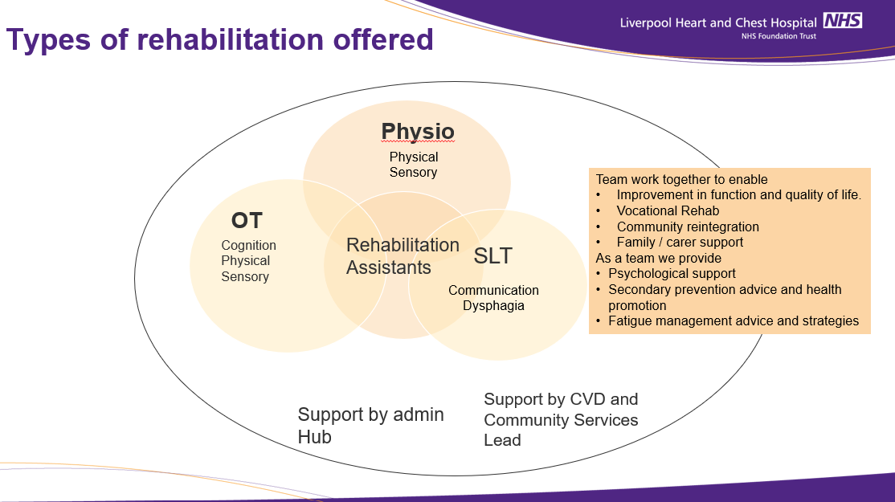
Stroke Rehabilitation Service
Criteria - New, confirmed diagnosis of stroke and Knowsley GP
No waiting list - fast responsive service (patients seen within 48 hours)
Not time limited. Rehabilitation continues whilst changes are being made and there are achievable rehabilitation goals
Work with patient and their families / carers
Encourage patients to return to access community as able
Offer 6 week, 6 and 12-month health and social care reviews.
Discharged once 12-month review complete and needs are met
SALT
Cognition
ISLA
FES
Virtual upper limb group
Walking Group
.

Slide 17
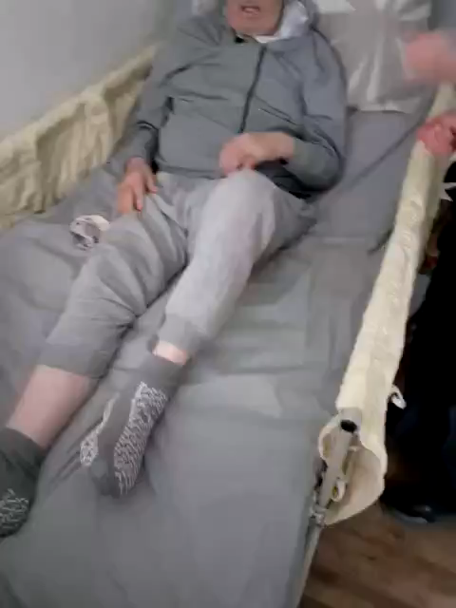
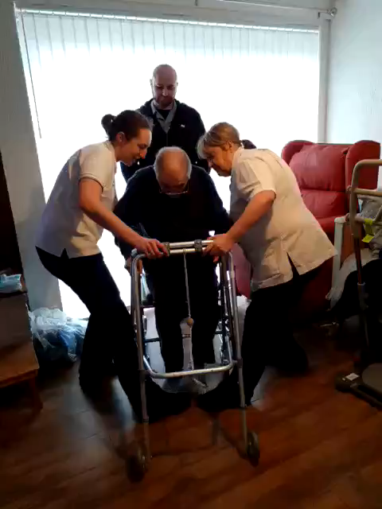
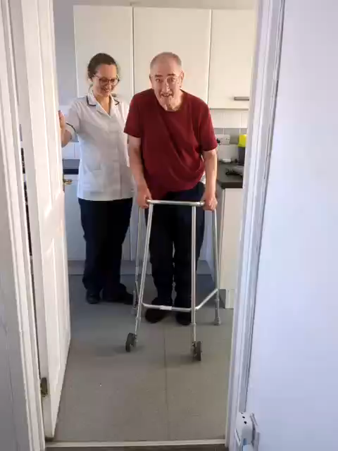
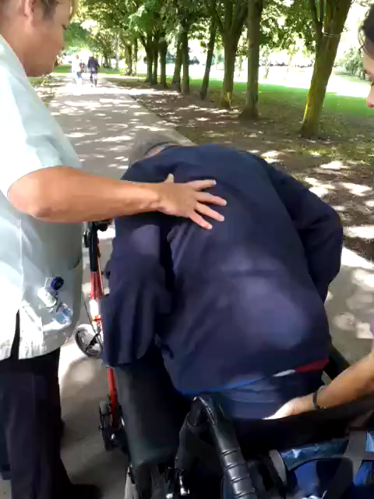

Slide 18
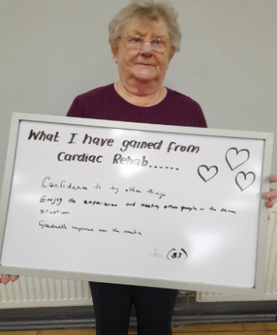
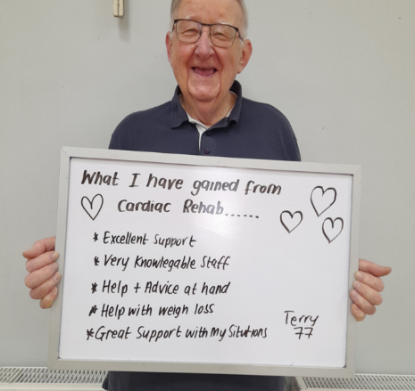
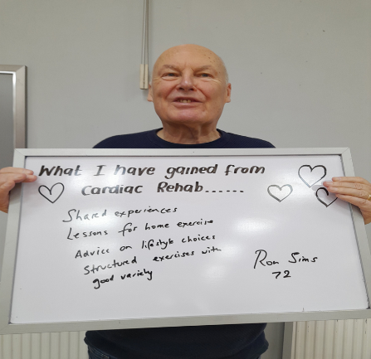
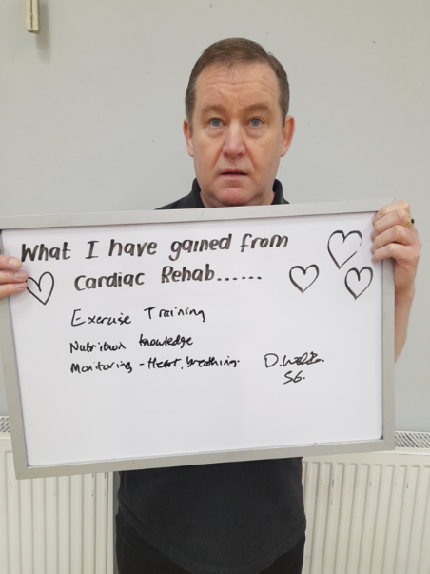
Some examples of good care > Patient feedback
This Photo by Unknown Author is licensed under CC BY-SA

Slide 19

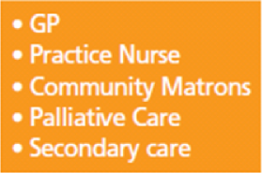
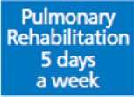
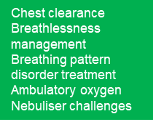


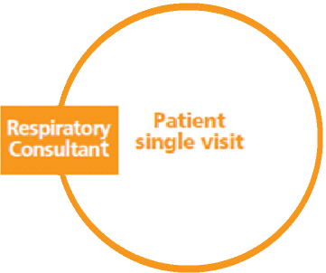
















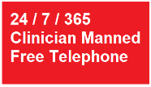

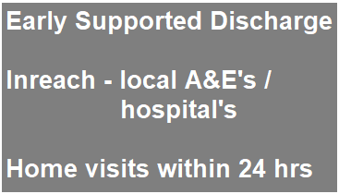
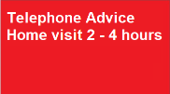
RESPIRATORY SERVICE 2025
INTEGRATED COPD
Swiss Nurse (A&E)
Assessment
999
Physio Consultant
Referral onto neighbouring respiratory teams
Asthma Hub
Alternative
PR
Nurse Consultant
COPD / Bronchiectasis
PR
Breathlessness management group
In house
CGL
Substance abuse recovery
CoD
Support
8-6 Mon-Friday
Palliative care
Home Oxygen Service
Pharmacist
O₂
Hospice
Oncall Consultant 8-8, 365 days per year

Slide 20

Rapid Response 24/7, 365 days
Nurse & Physiotherapy Led Service 08:00 - 20:00
Avoid unnecessary hospital admissions
Facilitate Early Supported Discharge (ESD)
Home visit within 2 hours Respiratory Nurse and/or Physiotherapist
Home visit within 24 hours Respiratory Nurse and/or Physiotherapist
History taking
Clinical assessment
Investigations i.e. arterial blood gases, sputum culture, CRP
Treatment packs (Patient Group Directions) - antibiotics, steroids, nebulisers
Acute respiratory physiotherapy
4 possible outcomes
  Reassure, alter treatment
  Manage exacerbations at home with appropriate treatment
  One stop consultant-led clinic
  Hospital admission
Consultant oncall 08:00 - 20:00
Monday to Sunday
Clinician of the Day (CoD) 08:00 - 18:00
Monday to Friday
Overnight free-phone telephone service (20:00 to 08:00) - advice and reassurance

Slide 21
Diagnostic & Respiratory Consultant-Led Clinics
Who is seen in the clinic?
Patients who present with respiratory symptoms
Known COPD/Bronchiectasis/Asthma patients
Complex respiratory cases requiring multi-disciplinary input
Possible diagnoses:
  COPD
  Bronchiectasis
  Asthma
  ILD (Interstitial Lung Disease)
  Lung cancer
  Heart failure
  Atrial fibrillation (AF)
Cross-sector holistic optimisation - integrated cardio-respiratory approach
MDT approach
Beyond inhaler therapy: health promotion/education, optimisation with long-term antibiotics, smoking cessation, pulmonary rehabilitation etc
Impact
↑ Quality of life and symptom control
↓ Exacerbation frequency and hospital admissions
Improved care coordination across respiratory, cardiac and primary care teams
Enhanced patient education and self-management
Optimised pharmacological therapy with evidence-based interventions
**Clinic appointments offered face to face and/or virtually**

Slide 22
Pulmonary Rehabilitation - what we offer
9-week course
  5 days per week
  2 sessions at the venues/gym
Other Services:
Urgent chest clearance
Respiratory clinics and home visits:
  Chest clearance
  Breathlessness management
  Breathing pattern disorders
  Ambulatory oxygen assessments
  6-minute walking tests
  Hypertonic saline & antibiotic nebuliser challenges
Community park walks
Community bike rides
Digital PR
Home PR
Engagement with AFL and C&M Anchor Group

Slide 23

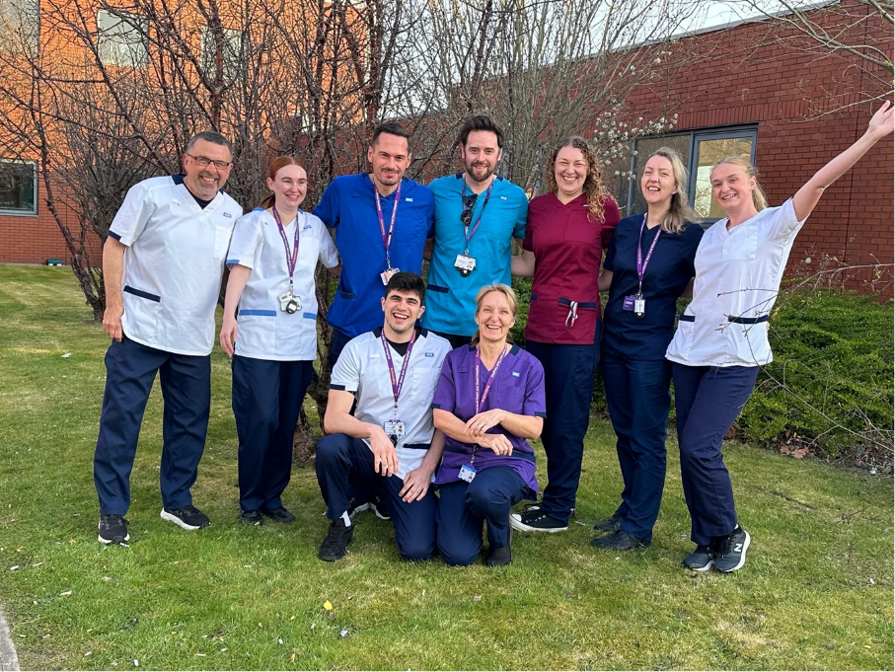
Pulmonary Rehabilitation Accreditation February 2025 - the service was assessed by the Royal College of Physicians and were able to demonstrate they met the best practice quality standards covering all aspects of a PR service, including quality and safety, patient experience and the workforce
They were the first team to achieve this across Cheshire & Merseyside
Feedback from the report included: the service should be congratulated on their cohesive, motivated and open ethos, culture and team approach, along with the visible and engaged leadership at all levels of the organisation

Slide 24



HOS-AR (Home Oxygen Service - Assessment & Review)
Home oxygen therapy
Long term oxygen therapy (LTOT)
Short burst oxygen therapy (SBOT)
Ambulatory oxygen therapy (AOT)
Palliative oxygen therapy (POT)
Conditions
COPD
Bronchiectasis
Heart Failure
OHS/OSA
Palliative Care
Cluster Headaches
Knowsley and Liverpool
334 Knowsley patients
298 Liverpool patients
Clinic Venues
Whiston
Kirkby
Huyton
Halewood
Garston
LHCH outpatients
Domiciliary assessments
Housebound
Palliative care
All new referrals assessed within 10 working days
All new LTOT patients reviewed at home within 4 weeks
All patients with home oxygen reviewed every 6 months
Weekly Oxygen MDT

Slide 25


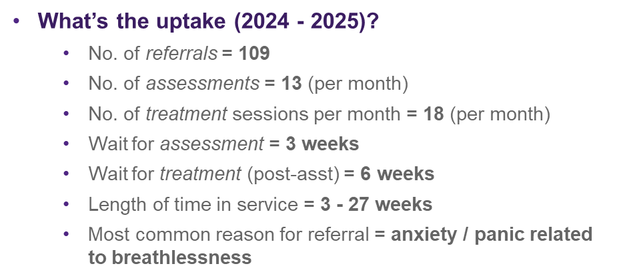


Clinical Health Psychology
What do we offer?
  Psychological & neuropsychological assessment
  Psychological therapy (6-8 sessions) for:
    Anxiety / panic related to breathlessness
    Low mood / depression, behavioural activation
    Difficulties with psychological adjustment to respiratory condition(s) - diagnosis, progression, transplant, end of life
  Delivery - telephone, online, community clinics, home visits
  Consultation - Oxygen MDT
  Psychoeducation - Pulmonary Rehabilitation, Smoking Cessation
  Supporting optimal MDT care (e.g. management of frequent callers to Rapid Response)
  Staff - Dr Julia Boot, Principal Clinical Psychologist (0.6 WTE) & Lorna Higgins, CBT Therapist (0.4 WTE)
Outcome of treatment | Median Score
Anxiety - Assessment (GAD 7) | 15/21 - Severe
Anxiety - End of Treatment (GAD 7) | 8/21 - Mild
Depression - Assessment (PHQ 9) | 16/27 - Severe
Depression - End of Treatment (PHQ 9) | 11/27 - Moderate

Slide 26
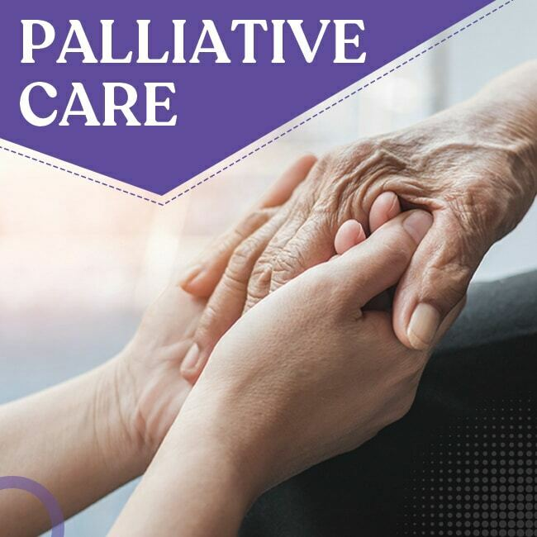
Life-style choices
Patients who have
advanced lung disease
KCRS palliative care register (259 patients - 30% increase since 2024)
Gold Standard Framework
PPC
Advance care planning
DNAR status
Bereavement support
Non-pharmacological interventions
Symptom control
Breathlessness management
Initiation of just in case medications
Monthly complex care MDT
Community Matrons
Community Palliative Care Team
GPs

Slide 27
Workforce Training & Capability, Inclusion & Health Inequality Focus
Team Lead training: Cheshire & Merseyside AHPs programme - Unconscious Bias, EDI, Equality Assessment, Race & Race Relations
Staff training: Determinants of Health, Health Inequalities & Chronic Respiratory Conditions in Knowsley
Inclusive PR assessments: adapted to capture health inequities, equality & diversity data, and individual support needs
Enhanced accessibility: staff trained as Wellbeing Champions and able to support with BSL
Language & communication support: multilingual team members providing interpretation for patients and LHCH
Community engagement: active promotion of PR, including presentations at Anchor Institution meetings
Quality improvement & equity projects: tackling barriers such as DNAs, completing HEAT, and working with stakeholders to address inequalities

Slide 28
Access, Communication & Inclusive Assessment
Access and Communication Support
Interpreter support available for spoken languages and BSL
Written materials provided in alternative languages
Family and carer involvement encouraged in letters, assessments, and appointments
Inclusive Assessment
Routine collection of ethnicity, gender, mental health, learning disability, alcohol/drug use, Index of Multiple Deprivation (IMD)
Early identification of inequalities, enabling personalised, tailored support for each patient

Slide 29
Screening, Tailored Care & Mental‑Health Support (PR Pathway)
Screening & Initial Assessment: Routine collection of ethnicity, gender, GAD‑7/PHQ‑9, learning disabilities, and deprivation scores from referral to assessment
Purpose: Early identification of inequalities and personalised support, including referrals to psychology, mental‑health services, and the GCL clinic
Adapted Care: PR programmes tailored for LD/MH needs (e.g., carer‑supported attendance; 1:1 home‑based PR for patients needing quieter or individual environments)
Mental‑Health Support & Safeguarding: Appropriate crisis support when patients disclose they are struggling, flexible engagement for UTA/DNA patients, and regular mental‑health reviews throughout PR

Slide 30
Supported Settings, Carer Education & Equitable Access
Patients reviewed in Supported & Residential Settings: Delivered in residential homes, supported‑living environments, and nursing homes
Carer/Family Involvement: Prioritised when patient capacity is limited to ensure safe, person‑centred care
Carer Education: Training provided on nebulisers, suctioning, and wider care‑support needs
Equitable Access: Referrals accepted from primary care, secondary care, social workers, and other partners
Joined‑Up Care: Ensures consistent, equitable access across the whole pathway

Slide 31
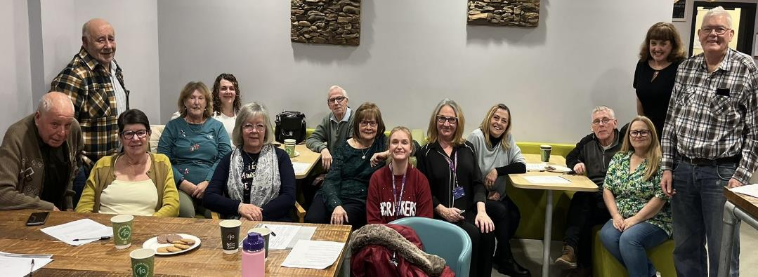
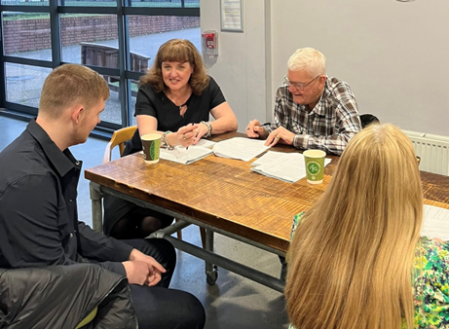
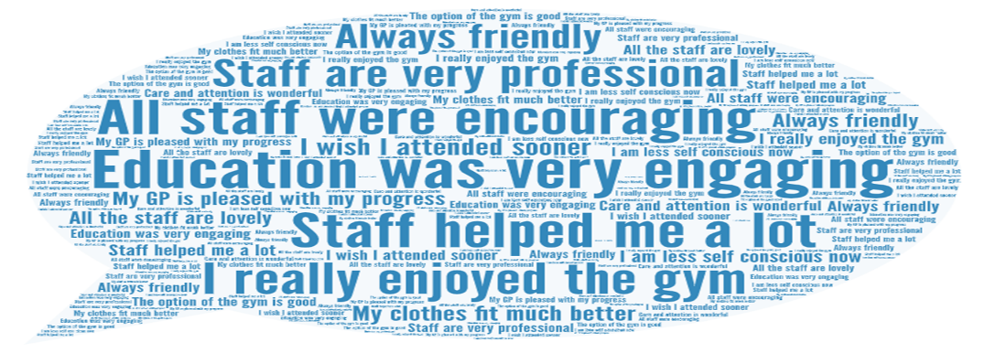
Patients are at the heart ♥️ of everything we do!

Slide 32


The service always receives outstanding feedback
Friends & Family Test
“Myself and my family would like to thank all the rapid response nurses and physiotherapists. They have always been there for me. They are so caring and understand my medical illness. No matter when I ring, they will always make a visit. We would be lost without them. They are true angels!”
“Assessed mum thoroughly. Gave her very good advice. Changed medication to a more appropriate device. Nurses were excellent, very compassionate towards mum. This is an amazing service. Quick to respond with excellent, caring, knowledgeable staff. Thank you for all your help. It is very much appreciated””
“This service is invaluable and has helped mum stay at home where she wants to be. Without the knowledge, expertise and support of this team, I don't think we would be able to manage. Thank you is just not enough, and I wish every local authority could provide the same level of service. We are extremely fortunate to live in Knowsley”
“Your staff are a credit to you…. they are amazing, friendly & professional. They were fantastic and knew exactly what they were doing. Thank you to the team for such a fast and wonderful service!”

Slide 33
Knowsley Cardio-Respiratory EDS Action Plan
Ensure equitable, high-quality cardiovascular and respiratory care
Align to NHS EDS
Focus on Knowsley population needs and the wider population at PLACE and ICB level
Address health inequalities in cardiovascular and respiratory care and link with the prevention agenda for patients and Staff
Improve uptake of NHS health checks, spirometry, AF detection, opportunistic testing and MECC
Improve access through community clinics and flexible appointments
Reasonable adjustments and accessible information
Monitor experience by protected characteristics
Support staff wellbeing and inclusion
Build confidence in delivering equitable care
Equality Impact Assessments for service changes
Clear accountability at Place and ICB level
Reduced inequalities in outcomes and access
Improved patient and staff experience
Learning & Sharing
Collaborative approaches

Slide 34
Thank you for listening….
Any Questions ?
❓

