Slide 1
LHCH EDS (Equality Delivery System)
Staff Health and Wellbeing

Slide 2
The Equality Delivery System (EDS) is a performance improvement tool developed by NHS England to help NHS organisations review and improve their equality performance. Originally introduced in 2011 and most recently updated as EDS 2022, it supports the NHS in meeting the requirements of the Public Sector Equality Duty (PSED) under the Equality Act 2010.The purpose of the EDS is to ensure that NHS organisations:
Deliver services that are fair and accessible to all, particularly those from protected characteristic groups.
Promote inclusive workplaces, where all staff can thrive and feel respected, regardless of their background.
Reduce health inequalities, by identifying gaps and setting actions to improve equity of access, experience, and outcomes.
EDS encourages transparency and accountability in how equality and inclusion are embedded across healthcare services and workforce practices. NHS organisations are expected to engage with both staff and external stakeholders, including patients and community groups, to gain diverse perspectives on their performance.

Slide 3
Why we involve Stakeholders in scoring
As part of the EDS process, NHS organisations are expected to gather feedback and invite stakeholders (including staff networks, union reps, and external partners) to review the evidence and rate the organisation’s performance. We do this because:
It brings lived experience into the assessment process.
It ensures that our self-assessment is balanced, inclusive, and evidence-based.
It creates accountability and encourages honest reflection.
It helps shape targeted and meaningful action plans to address identified gaps.
Stakeholder ratings are essential in validating our progress and helping to prioritise actions that will have the greatest impact on equity and inclusion in the workplace.

Slide 4
Scoring
Please refer to the Rating and Score Card supporting guidance document before you start to score. The Rating and Score Card supporting guidance document has a full explanation of the new rating procedure, and can assist you and those you are engaging with to ensure rating is done correctly Score each outcome. Add the scores of all outcomes together. This will provide you with your overall score, or your EDS Organisation Rating. Ratings in accordance to scores are below
Undeveloped activity – organisations score out of 0 for each outcome
Developing activity – organisations score out of 1 for each outcome
Achieving activity – organisations score out of 2 for each outcome
Excelling activity – organisations score out of 3 for each outcome

Slide 5
Scoring Criteria Example Based on 2A: When at work, staff are provided with support to manage obesity, diabetes, asthma, COPD and mental health conditions
Score: 0 – Underdeveloped Activity
Description: No or Little Activity Taking Place
Definition:
The organisation does not actively consider or prioritise workforce health.
There is no engagement with staff on managing their own health conditions.
Communication about available health-related support is rare or non-existent.
There is no evidence of regular signposting or awareness-raising around health conditions.
Score: 1 – Developing Activity
Description: Minimal or Basic Activities Taking Place
Definition:
The organisation shares basic reading materials about relevant health conditions.
Efforts to promote a healthy work-life balance are in place but limited in scope.
Signposting to external or national health support services is available but not comprehensive.
Staff are made aware of some resources but engagement or impact is not monitored.
Score: 2 – Achieving Activity
Description: Required Level of Activity Taking Place
Definition:
The organisation monitors the health of staff, including those with protected characteristics.
Self-management of health conditions is promoted to all staff across the organisation.
Sickness and absence data is used to support individuals in managing long-term conditions and to reduce workplace-related health risks.
Targeted support is provided for staff with protected characteristics relating to all mentioned health conditions.
A range of support is provided for healthy lifestyles and maintaining a work-life balance
Score: 3 – Excelling Activity
Description: Activity Exceeds Requirements
Definition
The organisation routinely monitors the health of the entire workforce.
Comprehensive support is available to enable all staff to actively manage their health through multiple channels (e.g., programmes, resources, services).
Absence and sickness data is proactively used to inform prevention and intervention strategies around long-term conditions.
Health literacy is a key organisational priority, with tailored education and information for staff.
The organisation offers innovative and accessible initiatives that promote work-life balance, physical activity, and overall wellbeing.

Slide 6
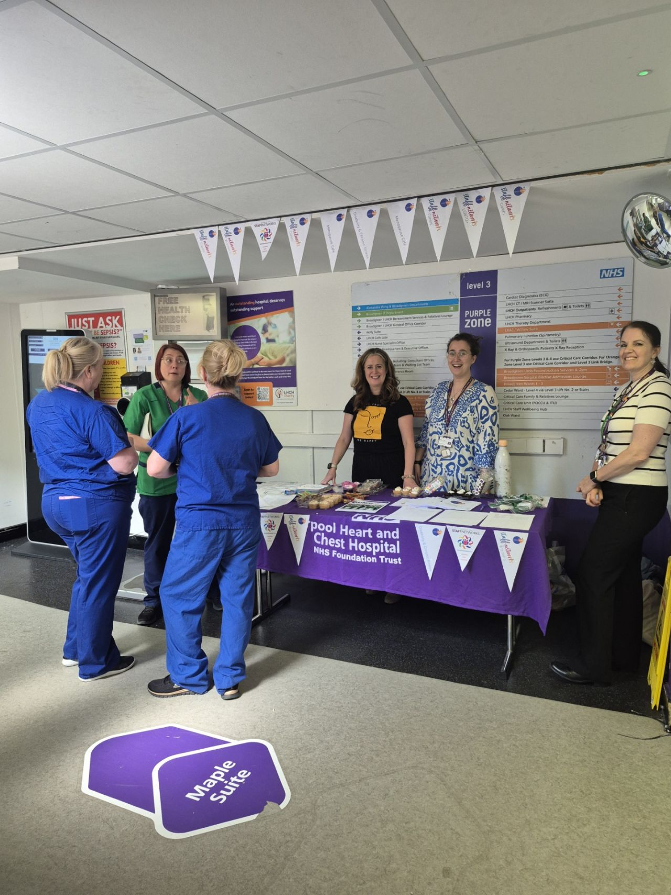
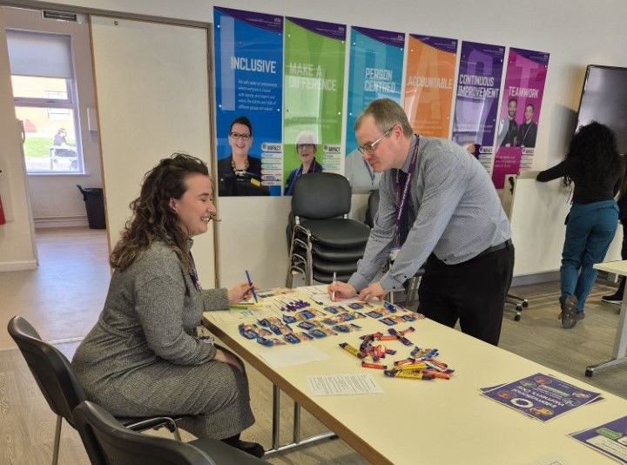
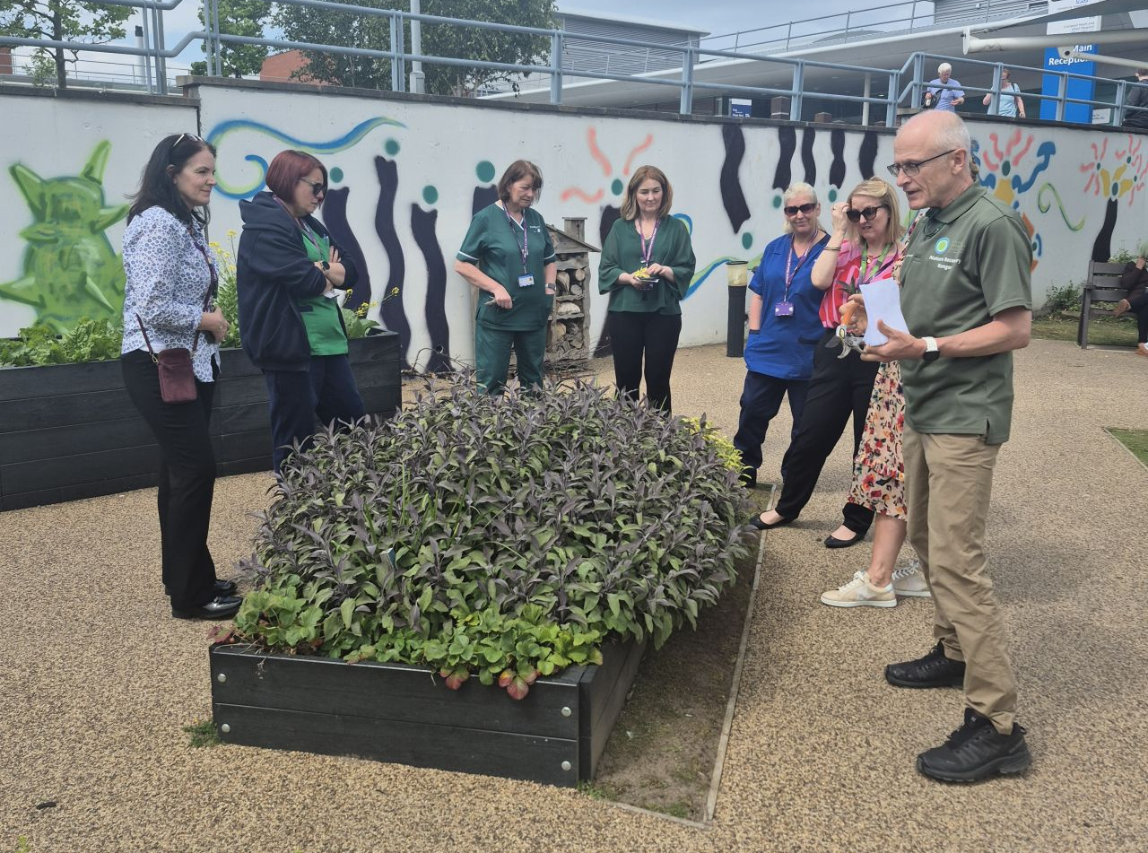
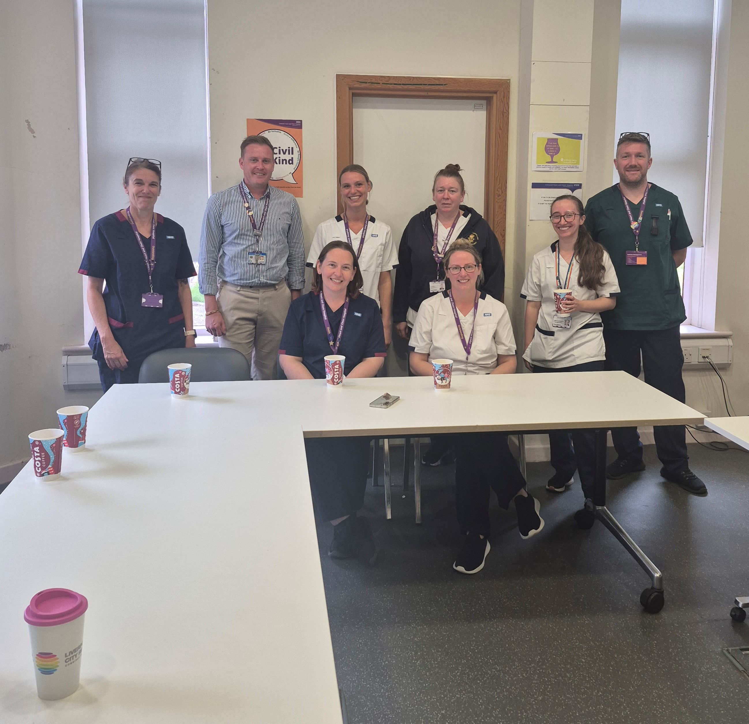
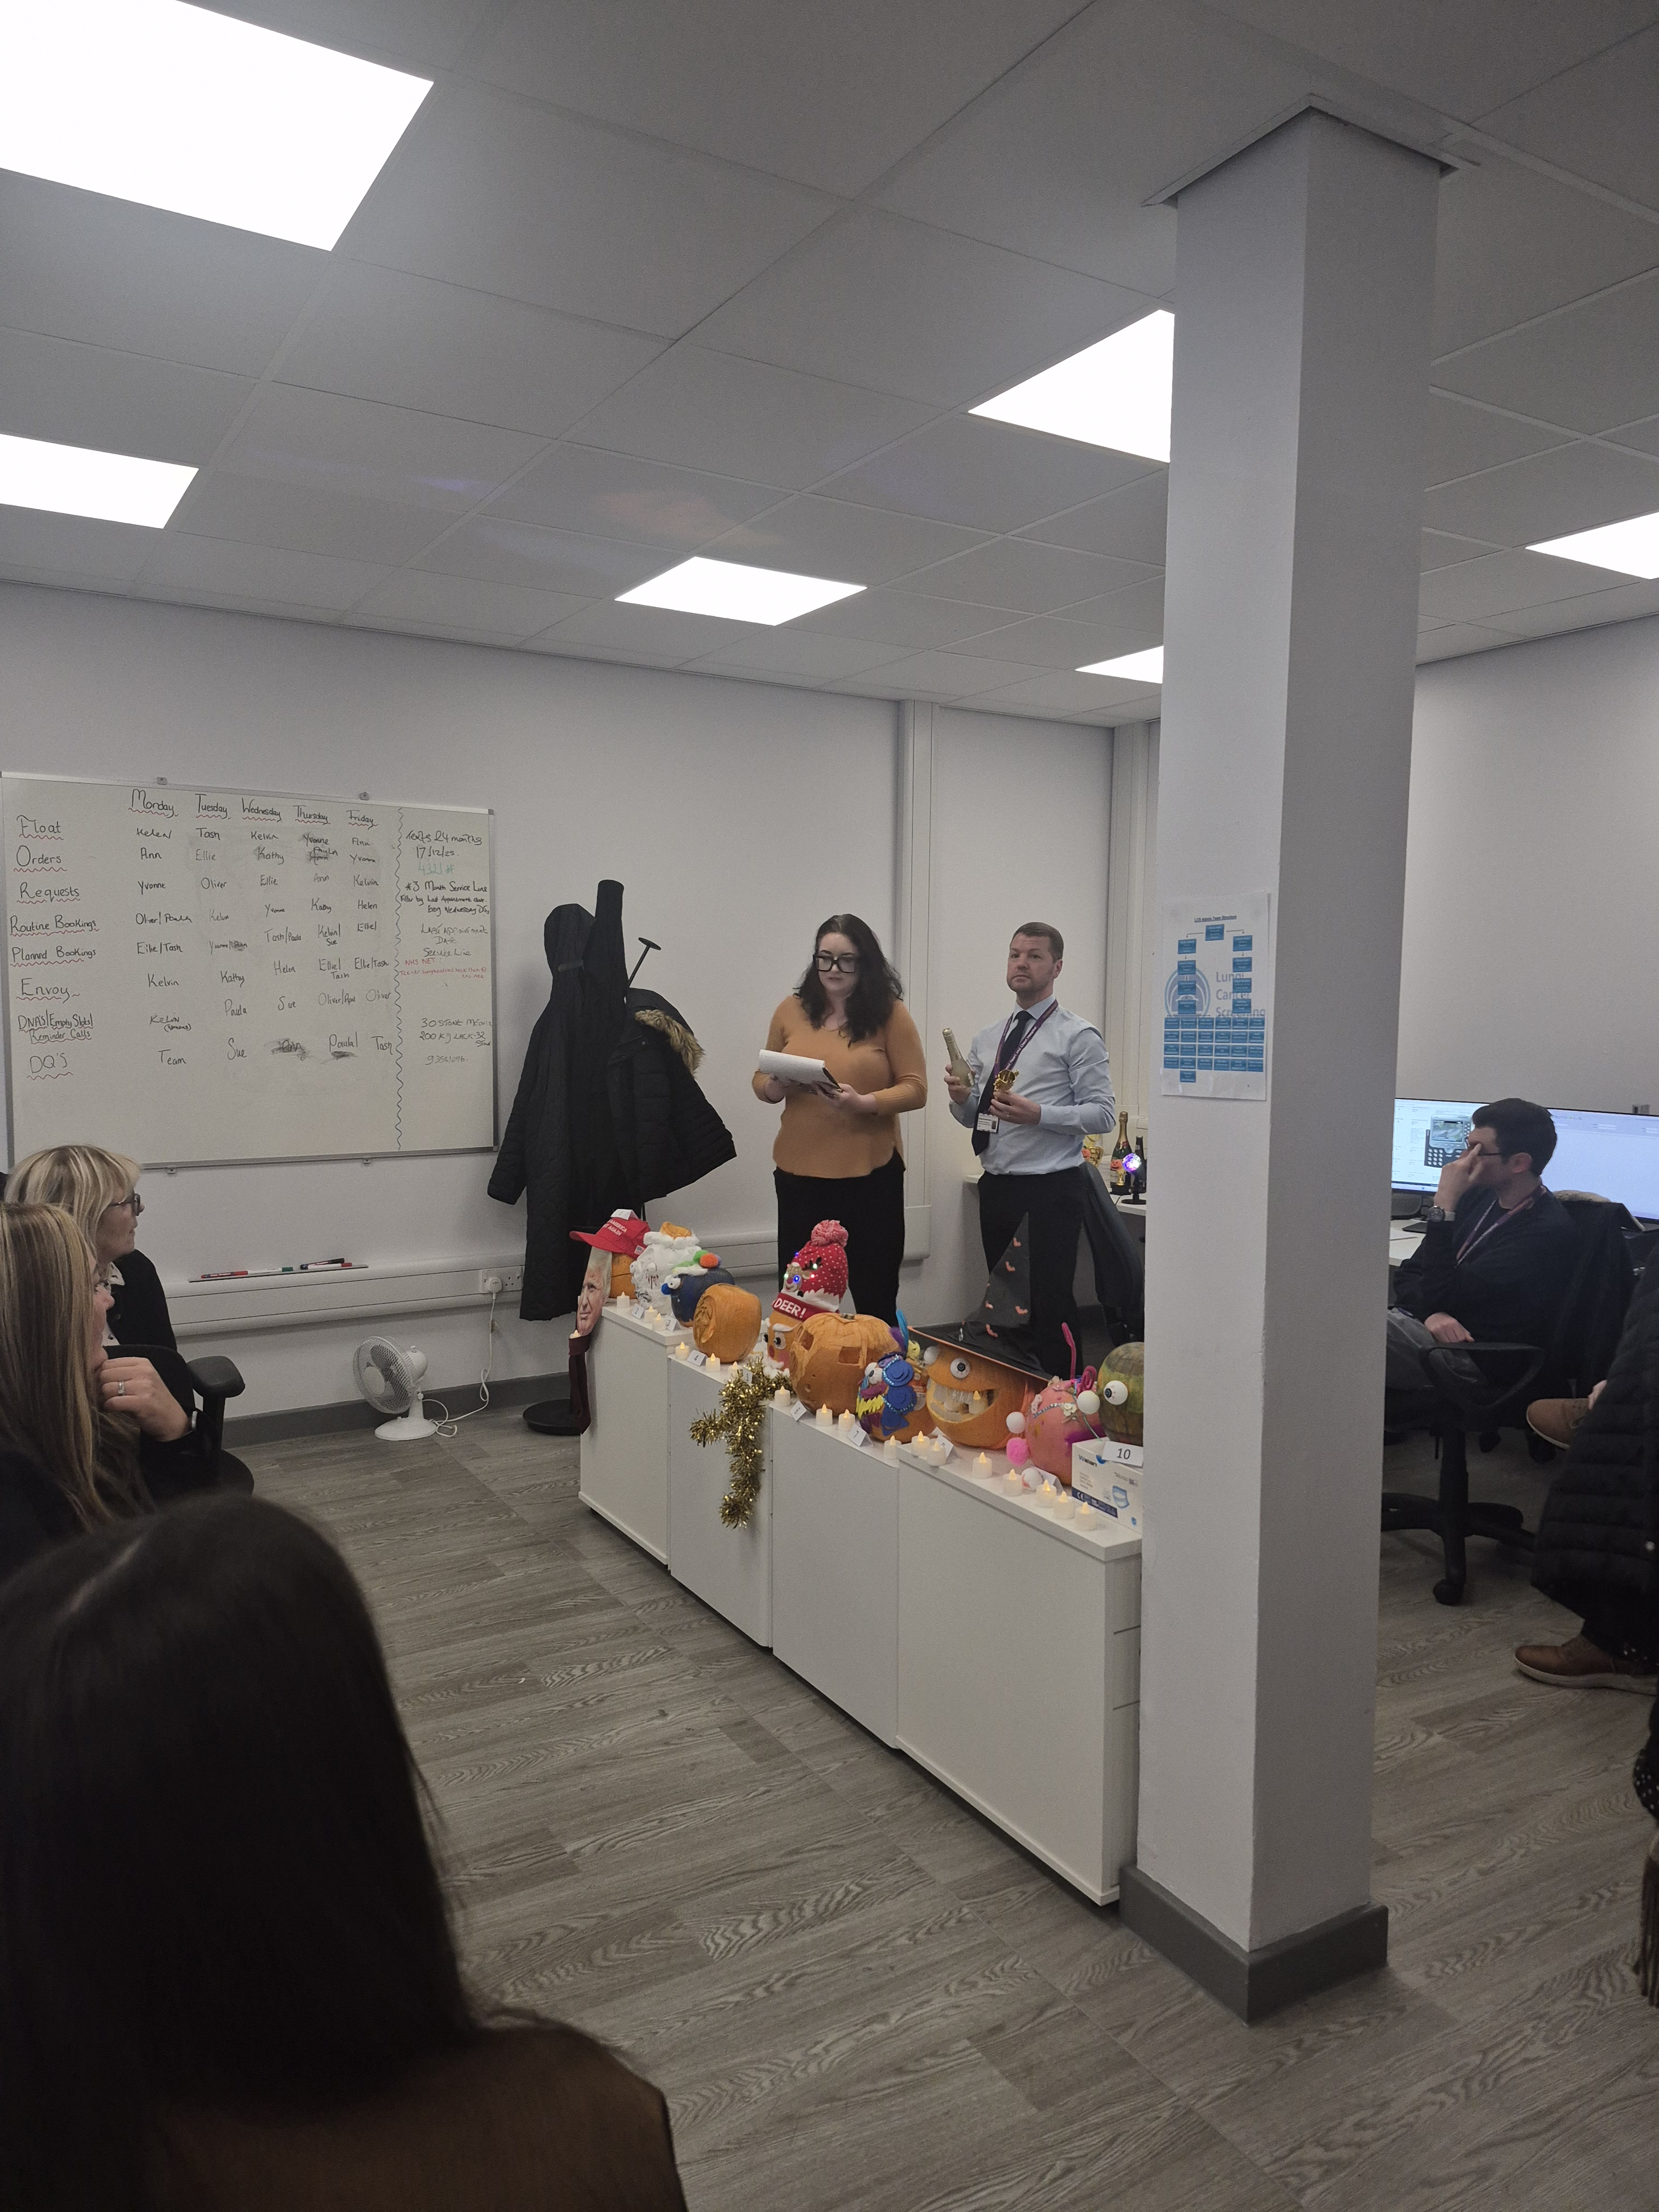
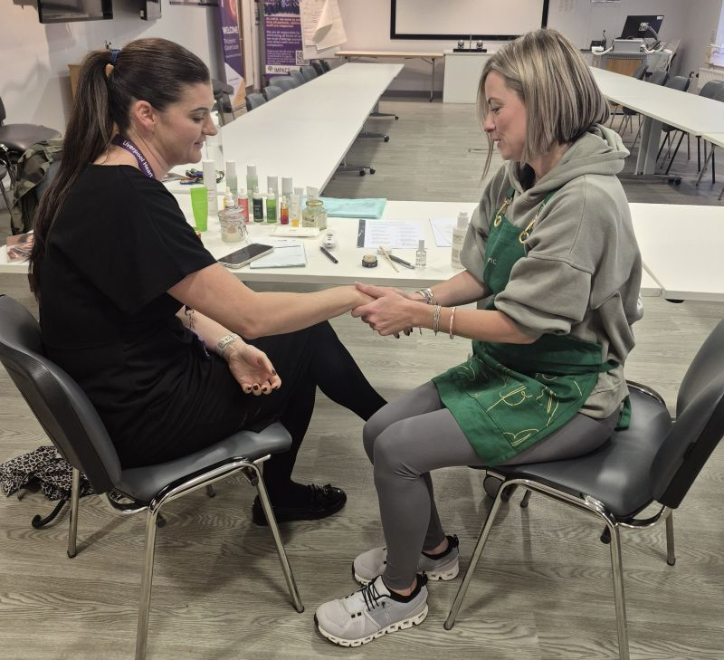
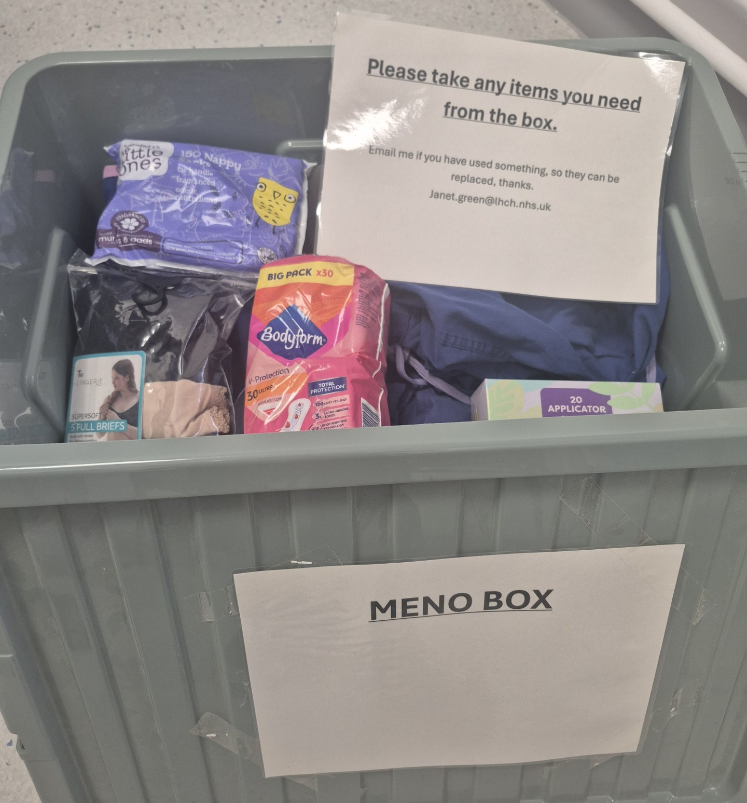
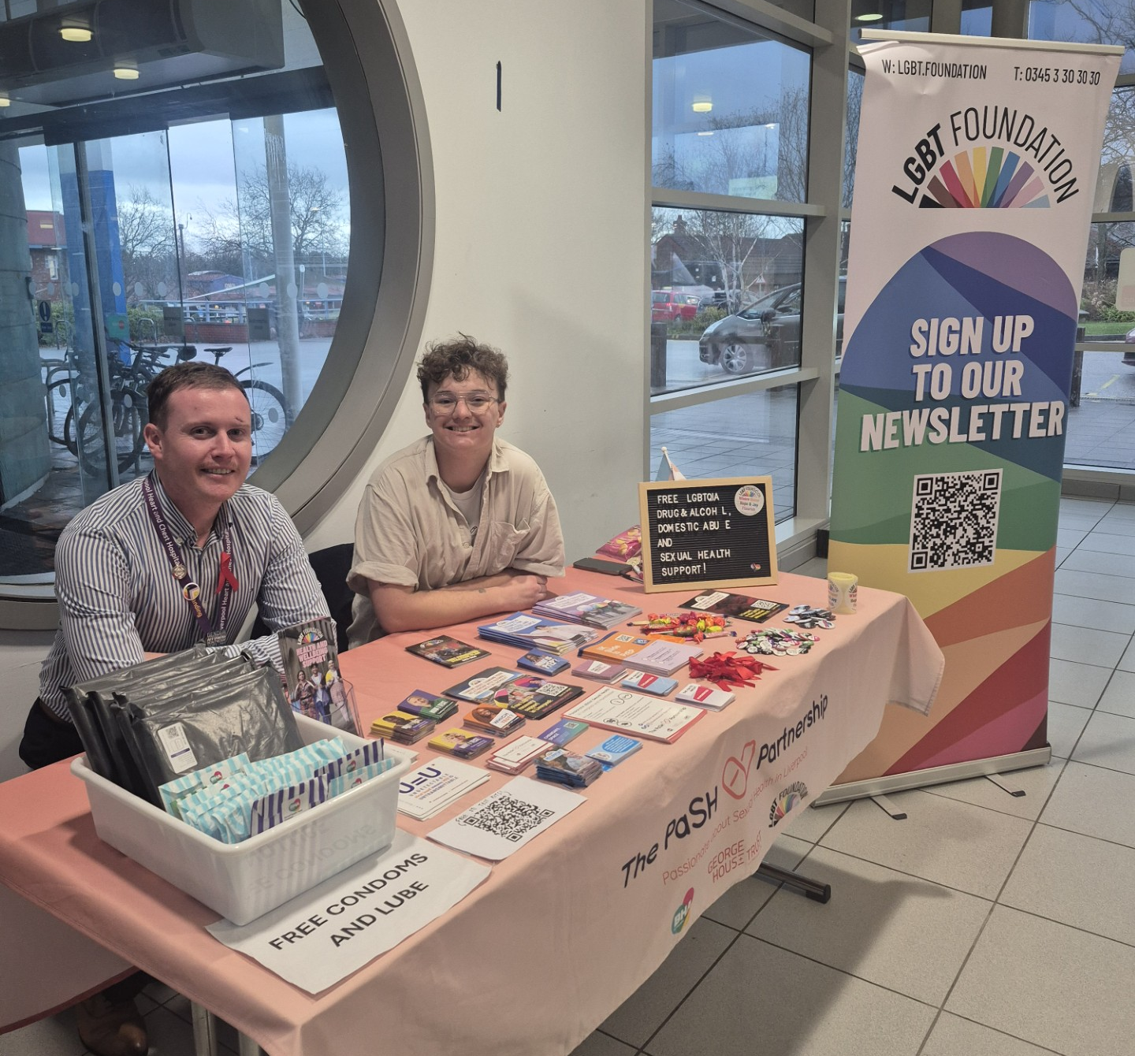
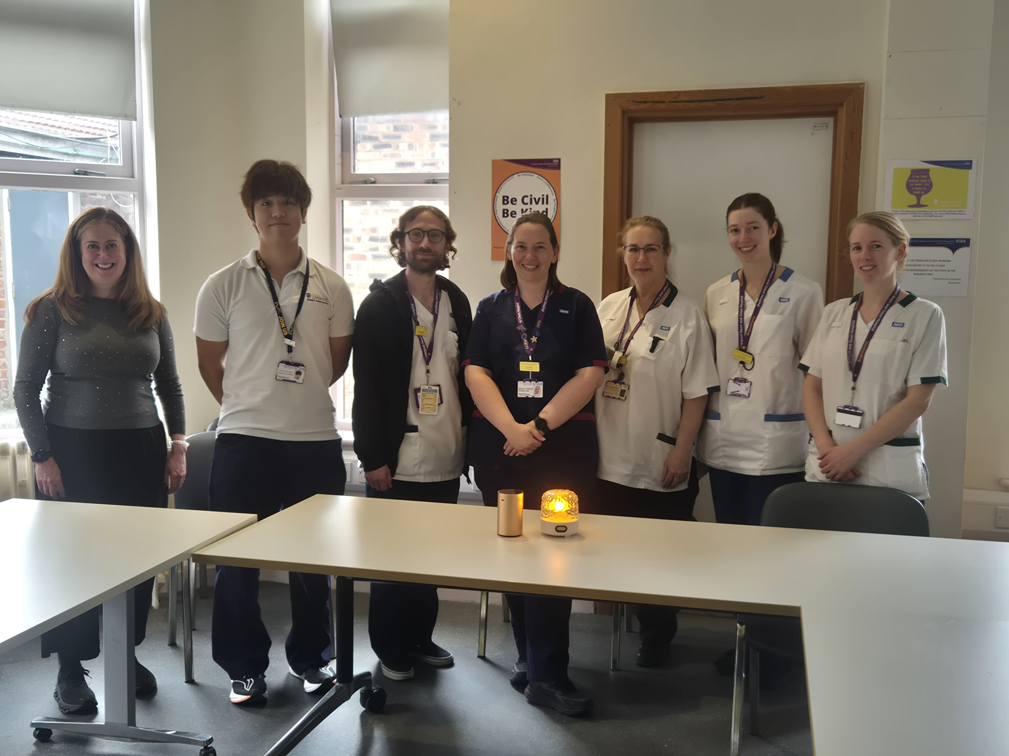
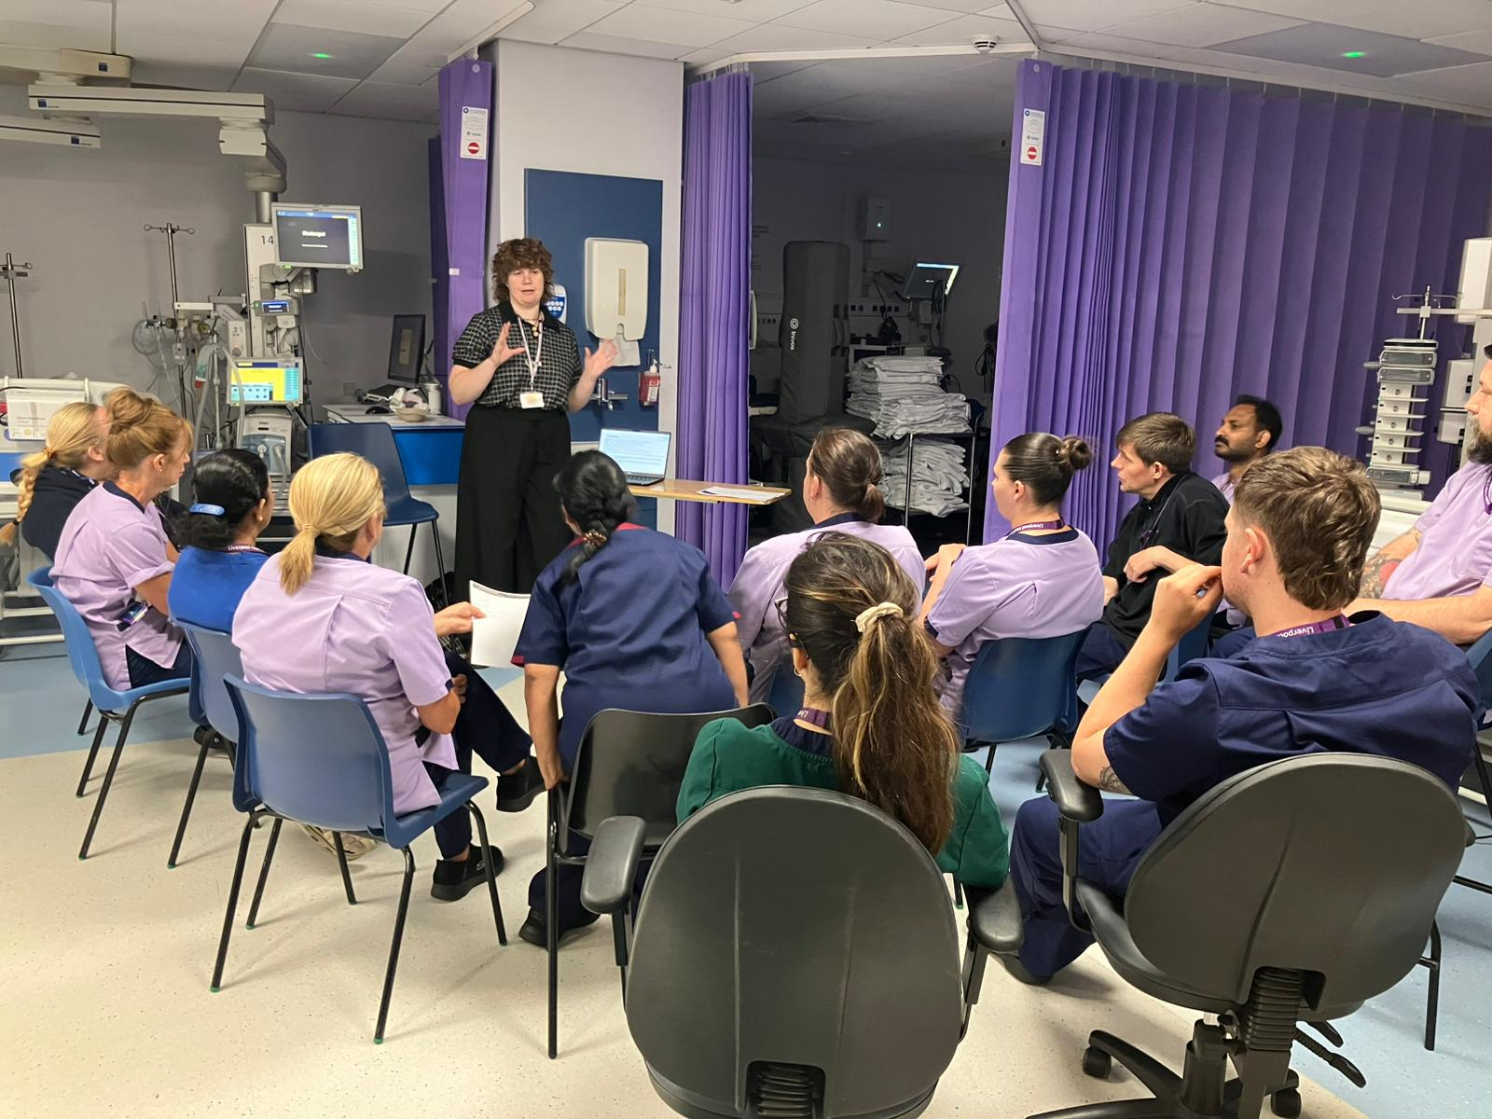

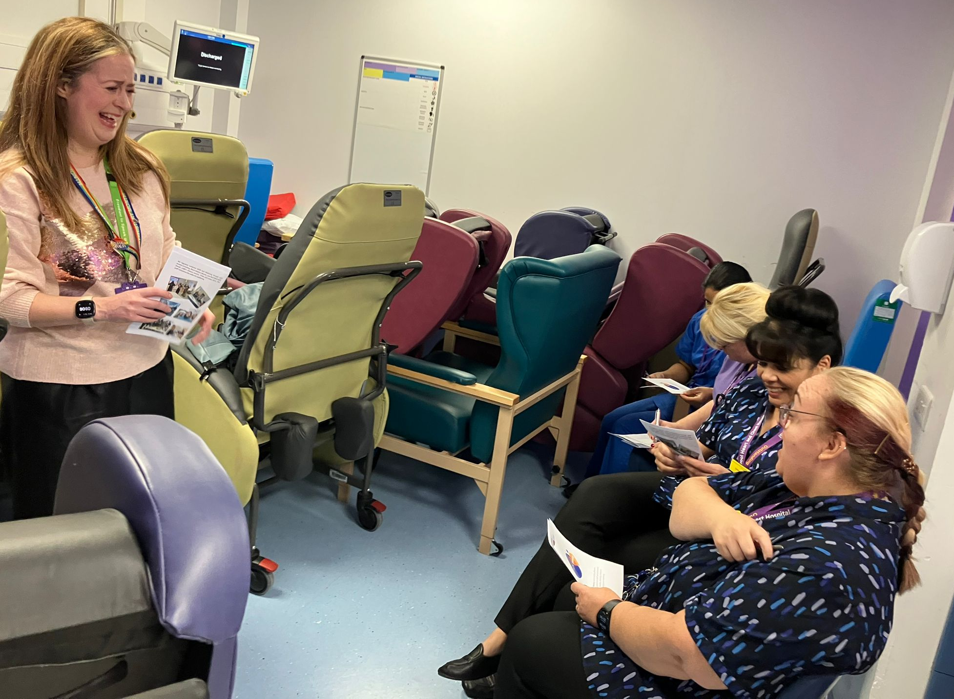
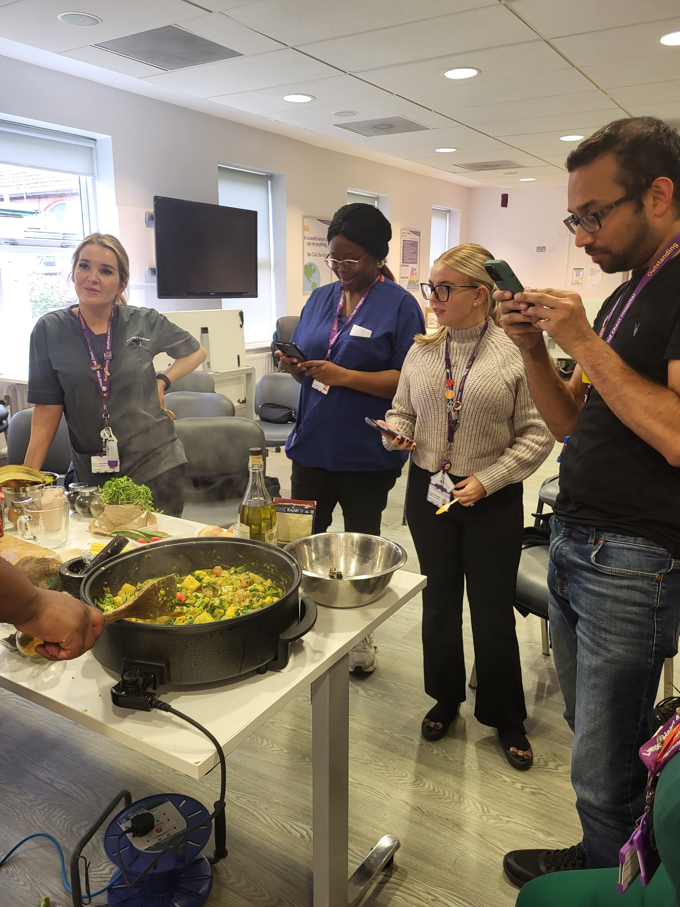
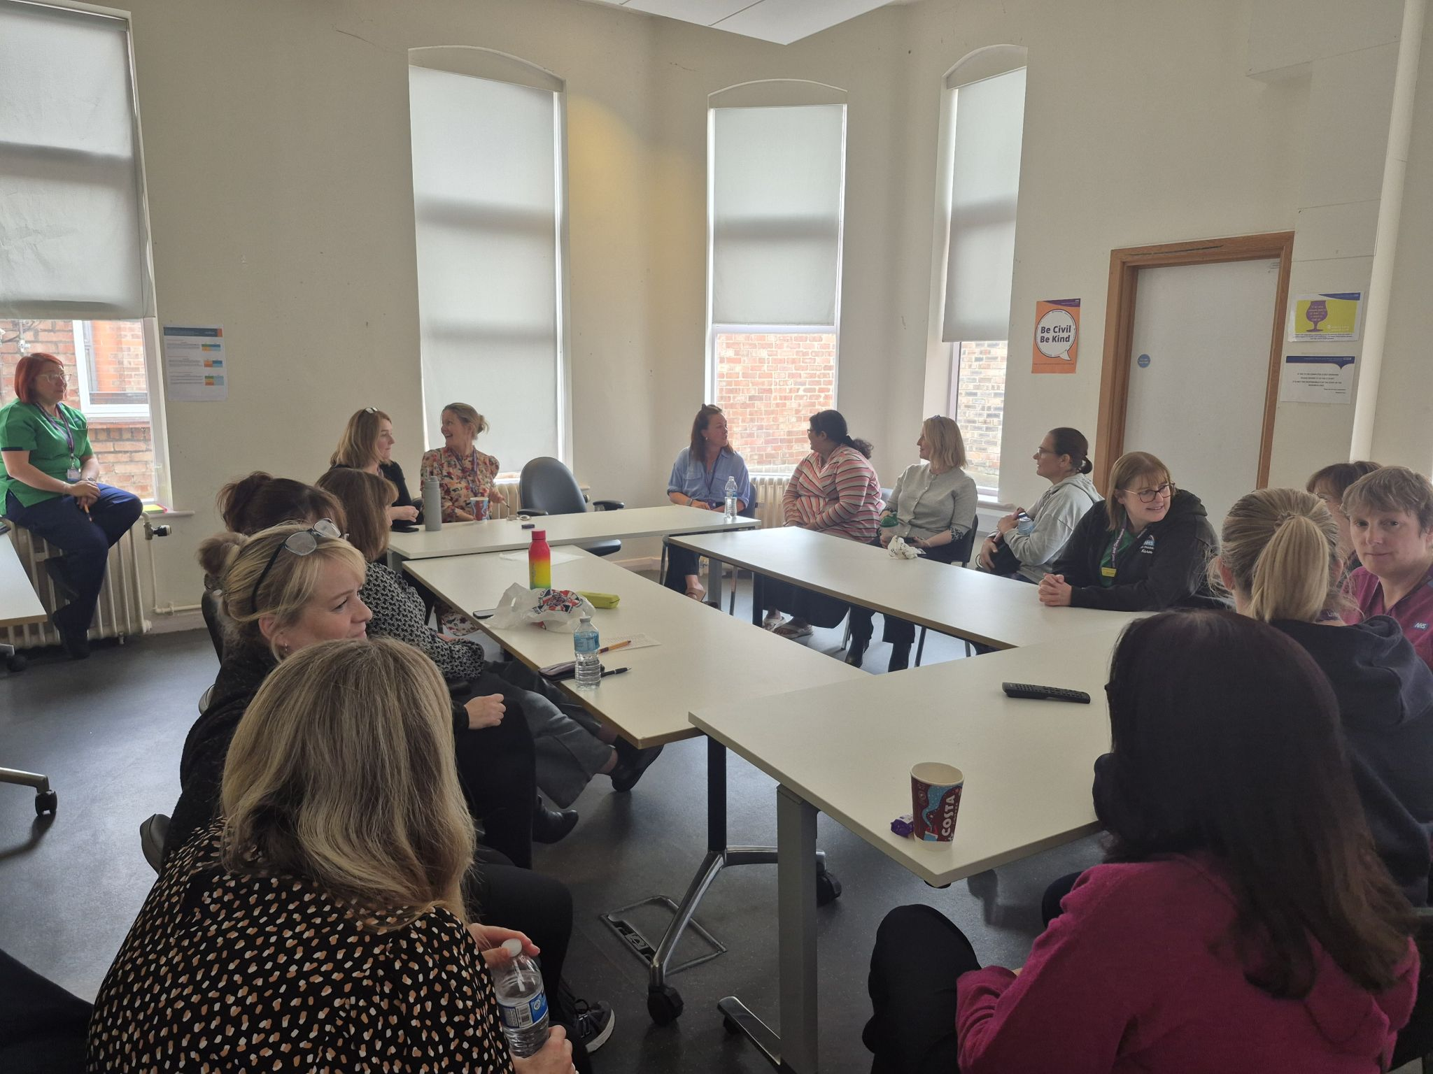
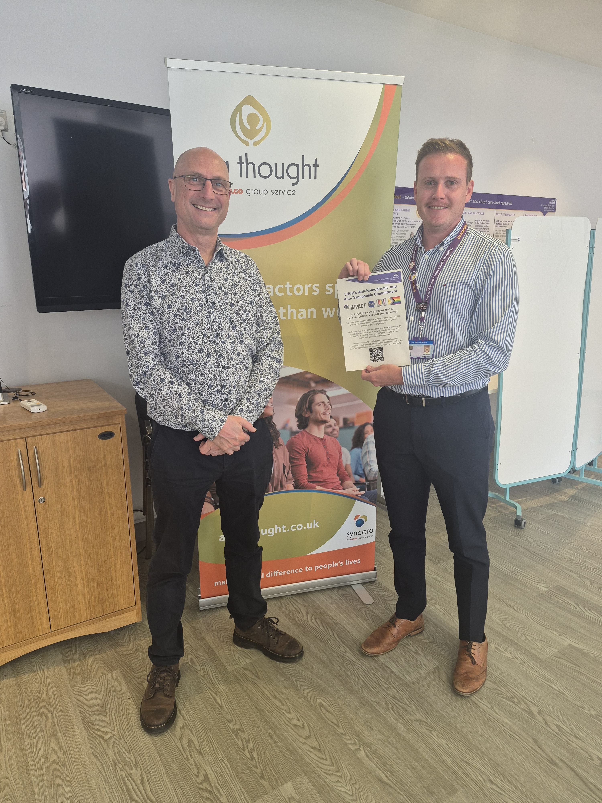

Slide 7
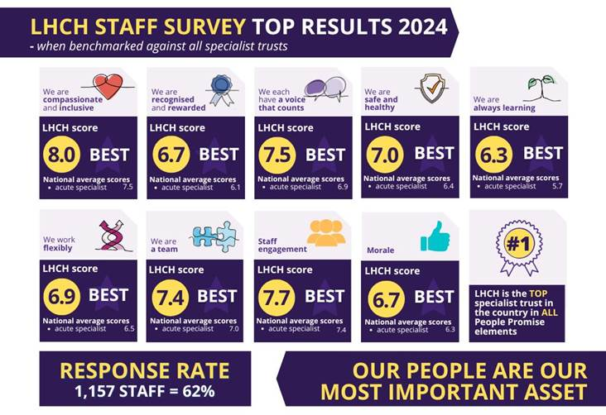
LHCH was the BEST acute specialist trust in the country in ALL People Promise survey elements in the NHS Staff Survey 2024

Slide 8
Domain 2
2A: When at work, staff are provided with support to manage obesity, diabetes, asthma, COPD and mental health conditions
Staff demographics
Trust people plan
Trust EDIB Objectives
Trust WRES and WDES reporting
Sickness absence reporting from integrated performance reports
Information on the Trust wellbeing offer
Information on the Occupational Health Service
Information on the EAP support
Information on the Psychological Staff Service
Information on the activity of the Health and Wellbeing Lead
2025 Staff Survey Health and Wellbeing questions split by protected characteristics
Procedure
Information on the Trust’s approach to flexible working
Staff Networks
Reasonable adjustments
Reiki
Staff gym and outdoor gym
450 staff accessed free health checks in 2025
Health kiosk
49 out of 50 surveyed staff said they had started making healthier choices, e.g. meal planning and increased physical activity after attending LWWW

Slide 9
Domain 2
2B: When at work, staff are free from abuse, harassment, bullying and physical violence from any source
Staff demographics
Trust People Plan
Trust EDI Objectives
Trust WRES/WDES/GPG reporting
Policies on bullying, harassment and abuse. A breakdown of incidents relating to violence and aggression reported via inPhase, split by protected characteristic
2025 Staff Survey – bullying, harassment and physical violence questions split by protected characteristic
Restraint training
Speak out safely campaign
Freedom to Speak Up Guardians
InPhase Reporting
Training sessions
Staff Networks
External Charter marks
Themed afta thought sessions
External speakers
Anti Racism campaign
Anti Homophobia/Transphobia campaign

Slide 10
Domain 2
2C: Staff have access to independent support and advice from suffering with stress, abuse, bullying, harassment and physical violence from any source
Staff demographics
Trust People Plan
Trust EDIB Objectives
Trust WRES, WDES and GPG reporting
Information on Freedom to Speak Up
Information on Employee Relations policies including equality impact assessment of those policies
Information on Staff Networks
Occupational Health Support
EAP
1-2-1 sessions with EDIB & Wellbeing Officer

Slide 11
Domain 2
2D: Staff recommend the organisation as a place to work and receive treatment
LHCH Staff Survey results for 2025 have scored as a top five Trust in the country for place to work and care is our top priority
Staff demographics
Trust People Plan
Trust EDIB objectives
Trust WRES/WDES/GPG reporting
2025 Staff Survey – engagement and experience questions split by protected characteristic
Information on exit interviews
Reduced turnover rate

Slide 12
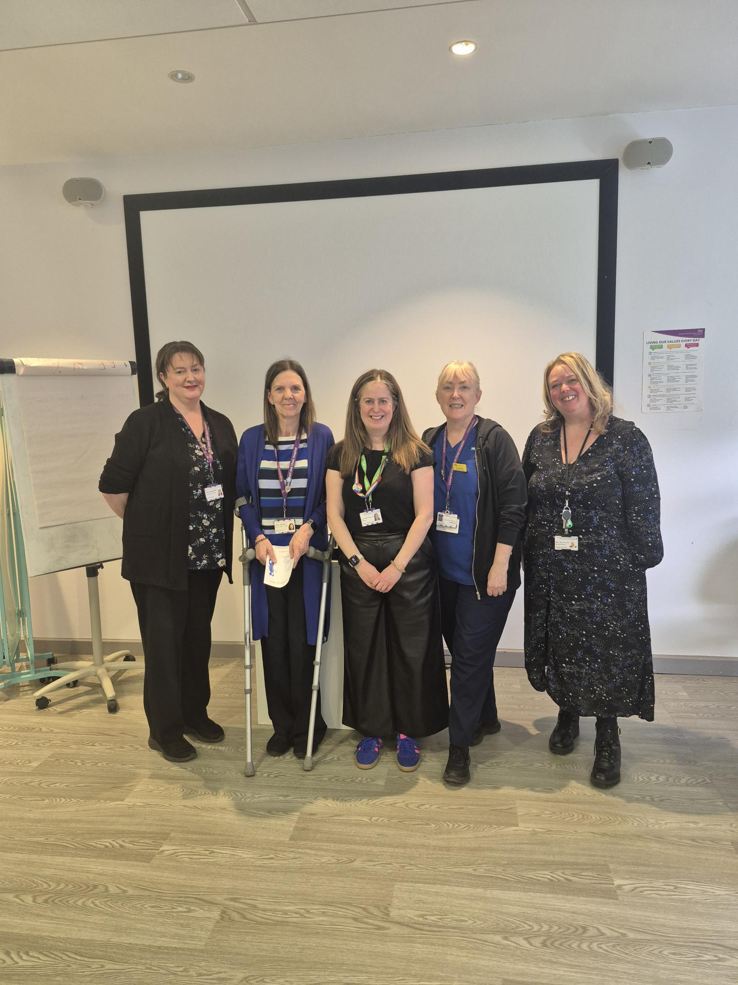
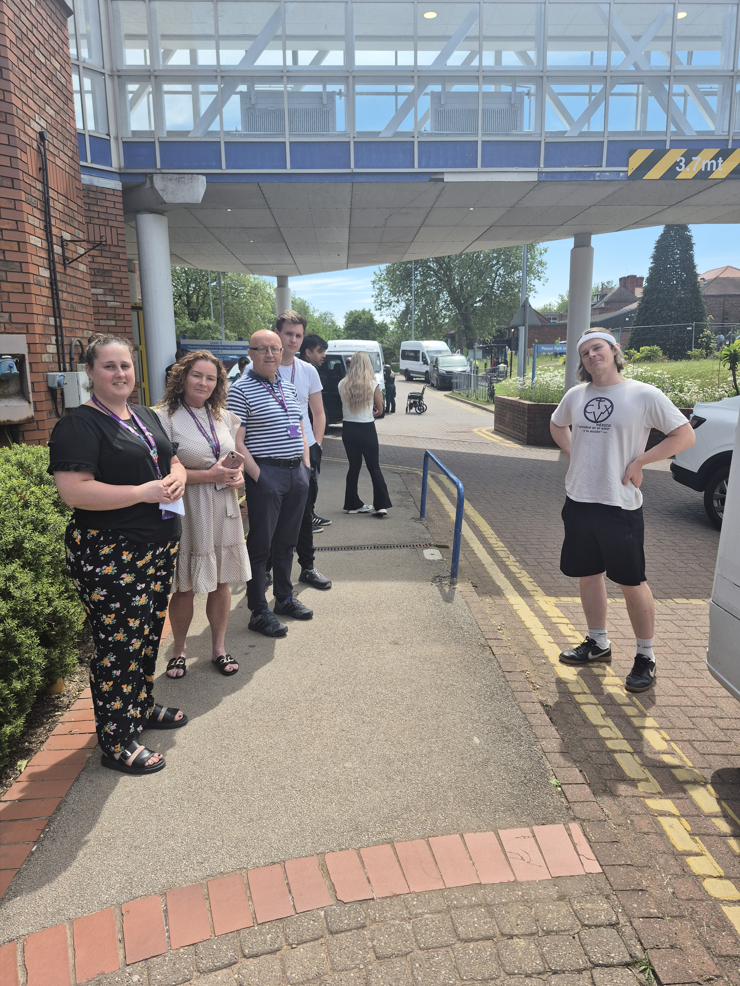
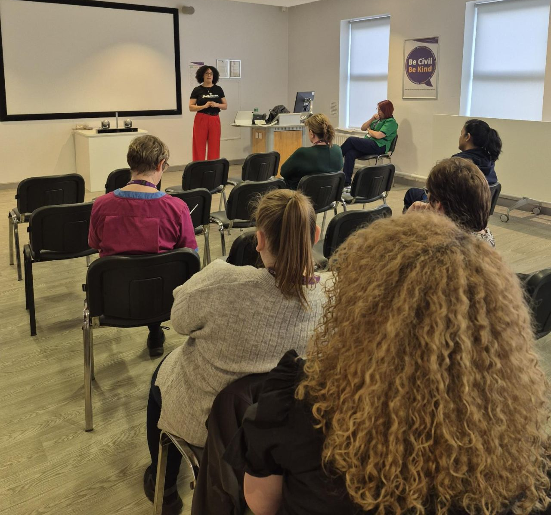
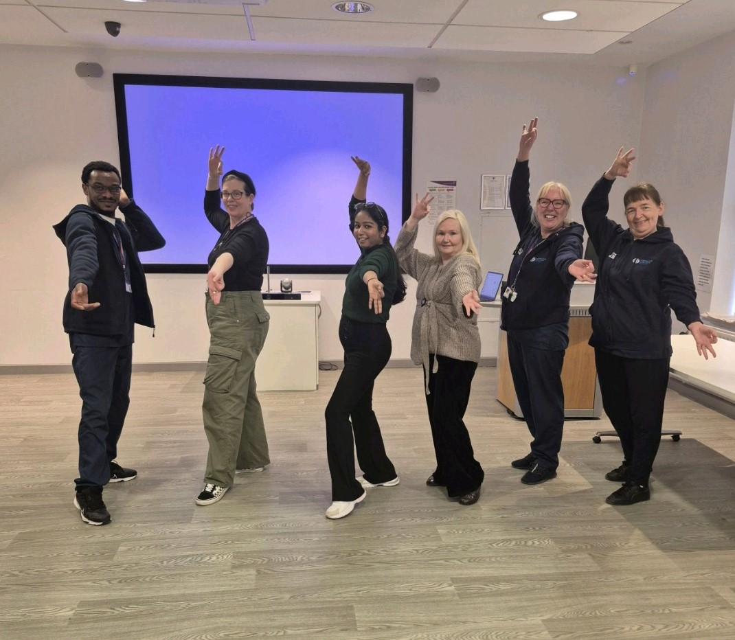
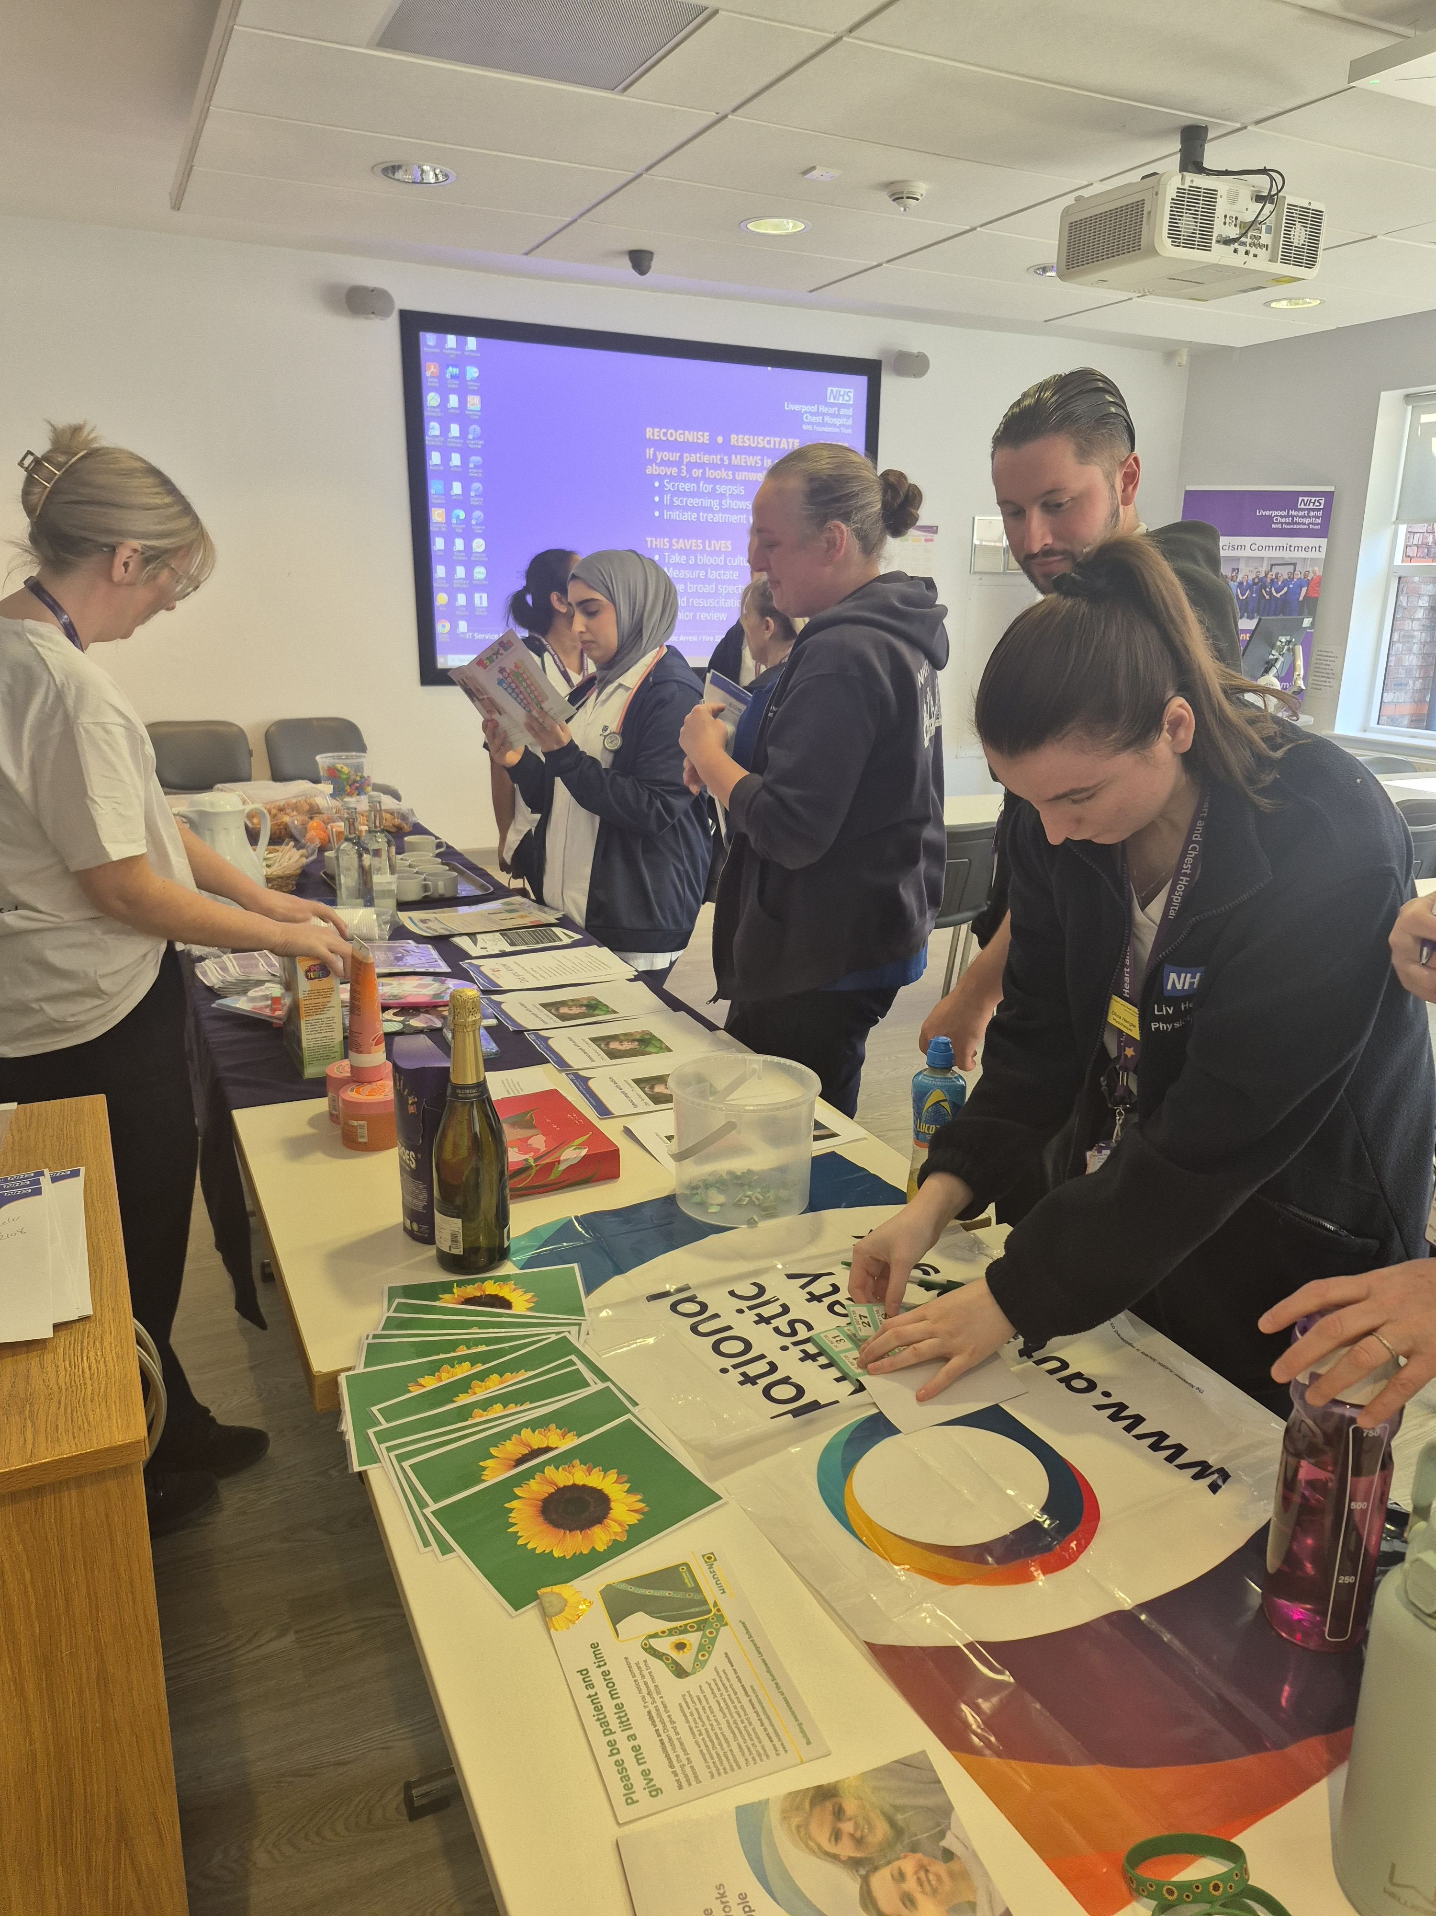
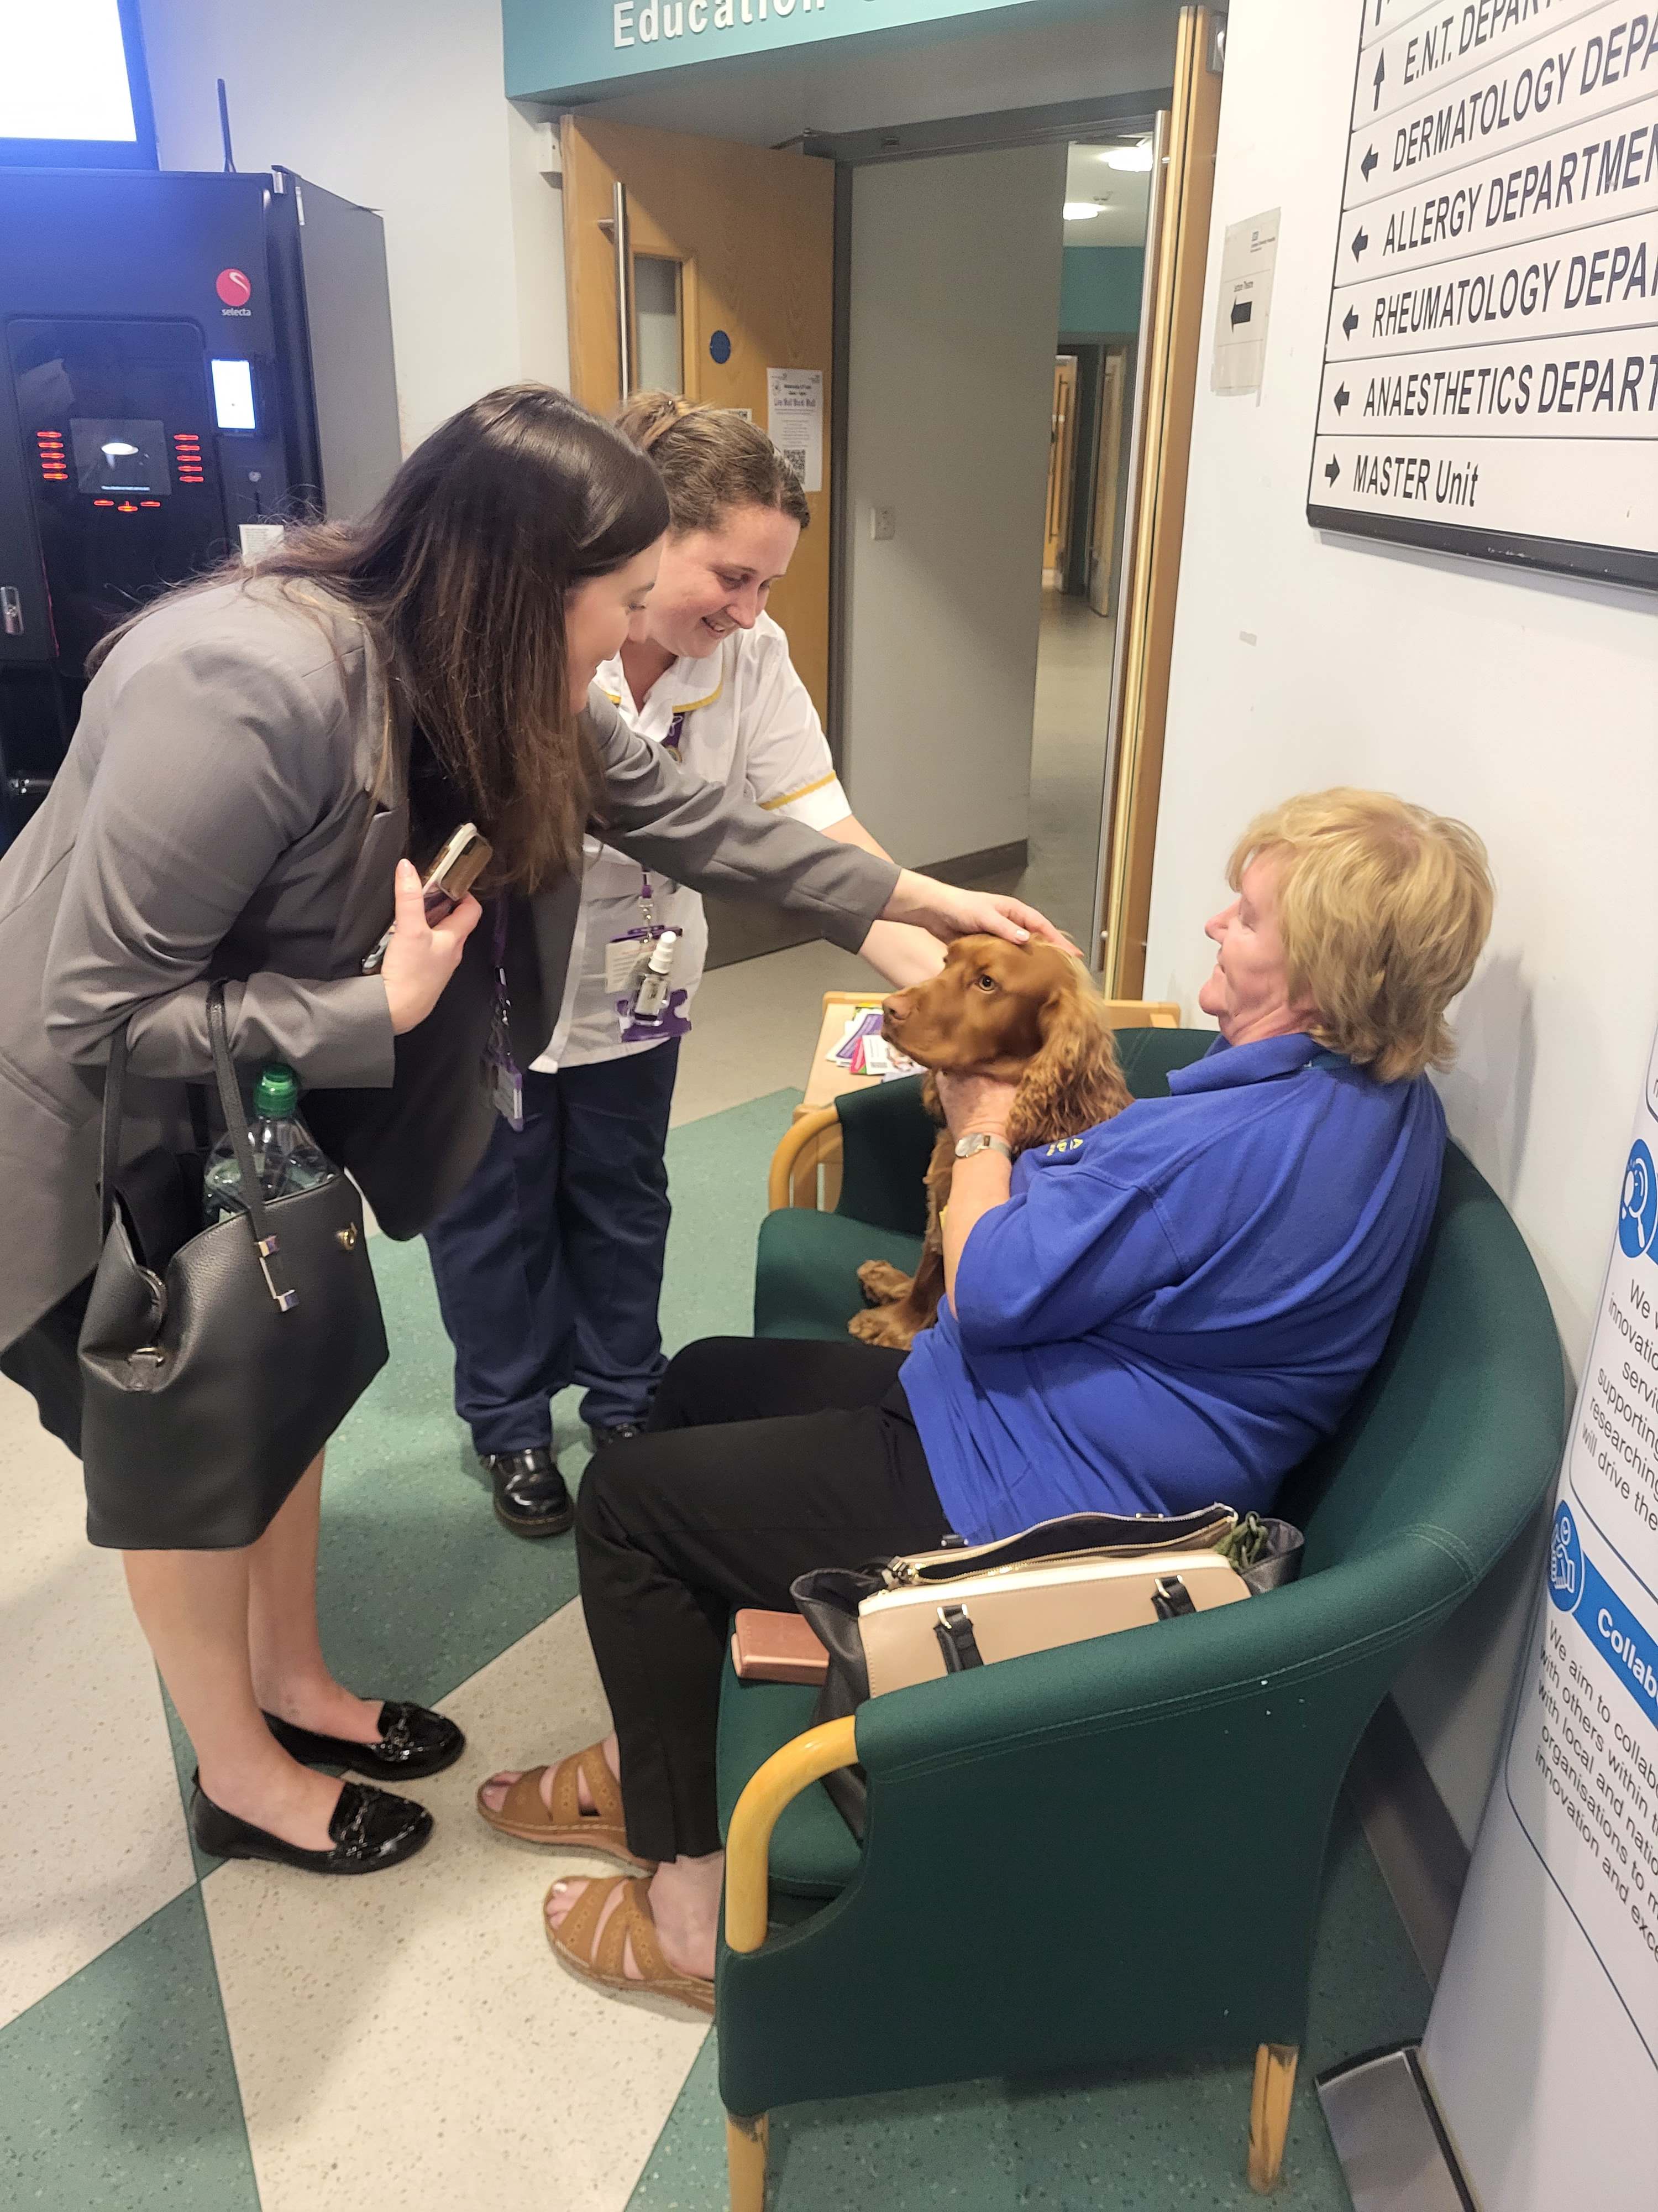
Afta thought 85 members of staff attended afta thought sessions in 2025. We produced themed sessions in partnership with staff networks including Pride and anti-racism.
Carers Drop in We provided a drop in session for staff to access expert information about support for carers including financial support, wellbeing support and more.
Queen of Greens We continued our partnership with Queen of Greens and managed to move the time and location to make it more accessible for staff to get affordable, fresh fruit and veg.
Awareness Training We continued to provide a variety of awareness sessions for staff including: Menopause awareness, Trans Awareness and sleep and mental health in menopause.
Awareness Days We celebrated awareness days such as Autism Awareness Day and Staff Networks Day
Live Well Work Well We were able to run two Live Well Work Well days where staff could access health checks, refreshments and different wellbeing offers.

