Slide 1
Audit Committee
Julian Farmer, NED and Audit Committee Chair

Slide 2
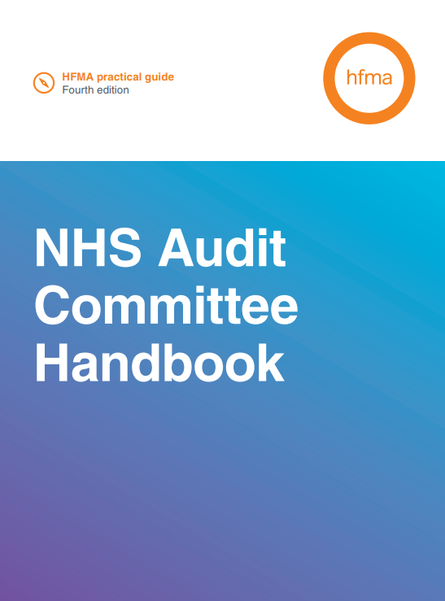
Why do we have an Audit Committee?
Every NHS organisation is required to have an audit committee that reports to its governing body (Board)
The Committee is unique in that membership is solely NEDs (excluding the Chair)
Responsible for ensuring effective governance, risk management and internal control
Scrutiny and review of ALL controls:-
  Financial systems
  Financial information
  Compliance with laws and regulations
  Risk management
  Clinical Quality
  etc.
Meets quarterly (plus an additional meeting to review the annual report and accounts)

Slide 3
What does the Audit Committee do?
Review all risk and control related disclosure statements
The policies for ensuring compliance with relevant regulatory, legal and code of conduct requirements and any related reporting and self-certifications
The policies and procedures for all work related to counter fraud and security as required by NHS Counter Fraud Authority
Controls and risk management arrangements associated with cyber security
Ensure that appropriate data quality standards are set and compliance with these standards is monitored.
Ensures effectiveness of internal and external audit, including approval of plans, tracking progress and outcomes of work and final opinions
Review the annual report and financial statements before submission to the Board of Directors
Review the Annual Governance Statement (AGS)

Slide 4
How does the Audit Committee fulfil its role?
KEY:
Management assurance reports (e.g. Cyber, data quality, clinical audit, NICE, research governance)
Internal Assurances
Assurance Committees (bi annual and annual reports)
External Assurances
Other
Provider licence compliance (quarterly)
Annual report and accounts
External Audit Plan
Board Assurance Framework Opinion (Annual)
Internal and External Audit Progress reports
Internal Audit Follow up report
Annual Governance Statement
Declaration of interests registers
Data Security and Protection Toolkit opinion (Annual)
Head of Internal Audit Opinion (Annual)
Internal Audit Annual Plan
Losses and special payments
Effectiveness of Internal and External Auditors
Recommendations Tracker
Anti Fraud Plan (Annual) and progress updates
Tender waivers
Risk Management KPIs
Corporate Governance Manual Review
External Audit Findings and opinion
Briefings (e.g. Bribery Act)
Changes to accounting standards
External visits

Slide 5
Examples/ Case studies
Research Finance
Management request for internal audit review to explore potential risks and issues
Limited’ assurance opinion received with clear agreed action plan
Follow up and tracking of progress against recommendations with management
Improvements to systems, processes and governance
Internal audit follow up
Bribery Act Compliance
Undertaken by our Local Counter Fraud Specialist (LCFS) as part of the annual plan
Initial review in 2011/12 as the legislation was introduced and periodic reviews to provide assurance
2021 review considered this in light of NHS revisions to some elements of procurement processes during Covid-19
Small number of actions regarding communication, contracts registers, and training implemented to further strengthen arrangements
Register of Interests
Management assurance showed a low completion rate for Trust decision makers for 21/22
Actions agreed to follow this up during March 2022 to ensure an improved position for year end
Final position at the 31st March was positive and provided assurance
This was sustained and further improved in 22/23.

Slide 6
2022/23 highlights and look ahead
In 2022/23 the Audit Committee will continue to focus its attention on the following:
Assurance processes underpinning recovery and reset of services;
Assurance processes to support data quality;
Assurance processes to support cyber security;
Assurance on risk management KPIs including the improvement work through the Risk Management Committee; New risk management system in 2023/24
Reviewing the approach to Committee effectiveness and annual report for all Assurance Committees;
Understanding and ensuring appropriate governance arrangements and risk management processes are in place to support wider systems / partnership working and emerging ICS frameworks; Further considerations for 2023/24

Slide 7
Questions?

