Slide 1
Discretionary Medicines

Slide 2
What this training will cover
A Brief overview of the Discretionary Medicines Policy
A List of medicines included in the Discretionary Medicines Policy
Who can give a medicine under the policy
Information on each drug within the policy
Instructions on how to show on EPR that you have given a medicine under the policy
Useful Contacts

Slide 3
Brief overview of the policy
Discretionary medicines are ‘Pharmacy Only’ or ‘General Sales List’ medicines that can be given to a patient, often the first dose only, without the authorisation of a prescriber or under a Patient Group/specific Direction.
Treatment with medicines in this policy may be administered by LHCH nurses who are band 5 or above without the authorisation of a prescriber; provided:
- Individual protocols are followed
- The treatment is recorded on EPR to show administration
- The treatment is documented in the ERP nursing notes
- The nurse has taken part in discretionary medicines training (this presentation) and passed the ESR assessment (which is to be undertaken after this training) EVERY TWO YEARS
An Audit is undertaken every 2 years to ensure compliance with the medications listed in this policy

Slide 4
Medicines included in the Discretionary Medicines Policy
Paracetamol
Glyceryl trinitrate (S/L tabs, spray)
Gaviscon Advance Liquid
Chlorphenamine tablets
Strepsils
Senna tablets/liquid
Simple Linctus
Nicotine Replacement Therapy (NRT)

Slide 5
Staff Competencies for discretionary medicines
Staff Competencies
Authorised Staff | Nurses band 5 and above
Additional Requirements | Completion of training on administration of discretionary medicines ESR

Slide 6
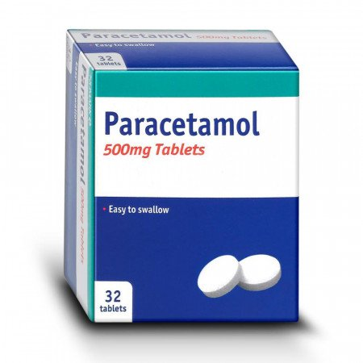

Paracetamol
Clinical condition or situation
Clinical Situation | Mild to moderate pain
Patients included | All patients with mild to moderate pain who are not excluded below
Patients Excluded | Patients under the age of 16 years of age Patients who are pregnant or breast-feeding Patients who are prescribed or have taken paracetamol contain product within the last 4 hours. Patients with renal impairment or active liver disease Patients with known allergy/hypersensitivity to paracetamol or its excipients.
Action for patients excluded | Refer to prescriber
Action if patient declines | Refer to prescriber and record in EPR notes

Slide 7
Paracetamol
Description of treatment
Medicine to be administered/supplied | Paracetamol 500mg tablets/ dispersible tablets/ suppositories
Dose schedule including maximum dosage | 1g every four to six hours
Maximum number of doses which can be administered under protocol for before review by a prescriber | ONE dose
Follow up/Patient advice | Inform patient of medicine being administered and rationale. If administered monitor patient and use clinical judgement to decide when to seek medical advice.
Record keeping | Doses must be recorded on EPR in the orders section under the title Nurse discretionary medicines Entry made in nursing notes document on EPR

Slide 8
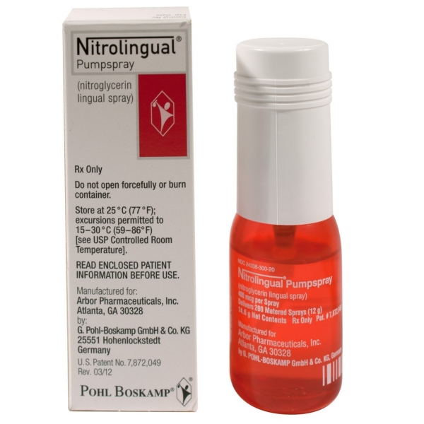
Glyceryl trinitrate (S/L tabs, spray)
Clinical condition or situation
Clinical Situation | Symptomatic relief of angina
Patients included | All patients requiring relief of angina who are not excluded below
Patients Excluded | Patients under the age of 16 years of age Patients who are pregnant or breast-feeding Allergy/hypersensitivity to GTN tablets or spray or any excipients. Patients with systolic blood pressure lower than 90mm Hg, hypotensive shock, severe anaemia, constrictive pericarditis, extreme bradycardia, Glucose-6-phosphate-Dehydrogenase-deficiency, cerebral haemorrhage and brain trauma, aortic and/or mitral stenosis and angina caused by hypertrophic obstructive cardiomyopathy. Patients with circulatory collapse, cardiogenic shock and toxic pulmonary oedema. Patients taking concurrent phosphodiesterase inhibitors such as Sildenafil, Tadalafil or Vardenafil or concomitant use with the soluble guanylate cyclase stimulator riociguat.
Action for patients excluded | Refer to prescriber
Action if patient declines | Refer to prescriber and record in EPR notes

Slide 9
Glyceryl trinitrate (S/L tabs, spray)
Description of treatment
Medicine to be administered/supplied | Glyceryl Trinitrate (GTN) 500micrgram tablets or 400microgram spray
Dose schedule including maximum dosage | One dose (Two sprays or one tablet) initially under the tongue. If no relief of symptoms within five minutes a further dose can be given.
Maximum number of doses which can be administered under protocol for before review by a prescriber | ONE dose
Follow up/Patient advice | Advise patient to close their mouth after administration Inform that a headache may develop following administration which may be relieved by paracetamol. Inform patient of medicine being administered and rationale. If administered seek medical advice in a timely manner
Record keeping | Doses must be recorded on EPR in the orders section under the title Nurse discretionary medicines Entry made in nursing notes document on EPR

Slide 10
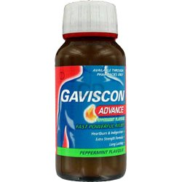
Gaviscon Advance Liquid
Clinical condition or situation
Clinical Situation | Indigestion/heartburn
Patients included | All patients with indigestion/heartburn who are not excluded below
Patients Excluded | Patients under the age of 16 years of age Patients who are pregnant or breast-feeding Patients with known allergy/hypersensitivity to Gaviscon advance or its excipients.
Action for patients excluded | Refer to prescriber
Action if patient declines | Refer to prescriber and record in EPR notes

Slide 11
Gaviscon Advance liquid
Description of treatment
Medicine to be administered/supplied | Gaviscon advance liquid
Dose schedule including maximum dosage | FIVE mL (5 mL) to be given initially after meals and/or at bedtime, if no relief of symptoms within 30 minutes a further FIVE mL (5 mL) can be given.
Maximum number of doses which can be administered under protocol for before review by a prescriber | 10ml (see above)
Follow up/Patient advice | Inform patient of medicine being administered and rationale. If administered monitor patient and use clinical judgement to decide when to seek medical advice.
Record keeping | Doses must be recorded on EPR in the orders section under the title Nurse discretionary medicines Entry made in nursing notes document on EPR

Slide 12
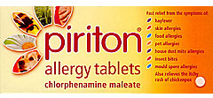
Chlorphenamine tablets
Clinical condition or situation
Clinical Situation | Symptomatic relief of allergy
Patients included | All patients requiring relief of allergy who are not excluded below
Patients Excluded | Patients under the age of 16 years of age Patients who are pregnant or breast-feeding Known allergy/hypersensitivity to chlorphenamine tablets or any excipients. Patients who have been treated with MAOIs within the last fourteen days
Action for patients excluded | Refer to prescriber
Action if patient declines | Refer to prescriber and record in EPR notes

Slide 13
Chlorphenamine tablets
Description of treatment
Medicine to be administered/supplied | Chlorphenamine 4mg tablets
Dose schedule including maximum dosage | One 4mg tablet
Maximum number of doses which can be administered under protocol for before review by a prescriber | ONE dose
Follow up/Patient advice | Inform patient of medicine being administered and rationale. If administered monitor patient and use clinical judgement to decide when to seek medical advice. If given for suspected drug allergy seek medical advice in a timely manner.
Record keeping | Doses must be recorded on EPR in the orders section under the title Nurse discretionary medicines Entry made in nursing notes document on EPR

Slide 14
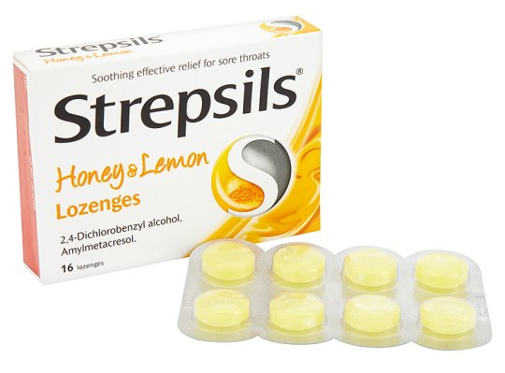
Strepsils
Clinical condition or situation
Clinical Situation | Sore throat
Patients included | All patients with sore throat who are not excluded below
Patients Excluded | Patients under the age of 16 years of age Patients who are pregnant or breast-feeding Known allergy/hypersensitivity to Strepsils honey and lemon lozenges or any of the excipients.
Action for patients excluded | Refer to prescriber
Action if patient declines | Refer to prescriber and record in EPR notes

Slide 15
Strepsils
Description of treatment
Medicine to be administered/supplied | Strepsils Lozenges (1.2mg 2,4-Dichlorobenyl alcohol and 0.6mg Amylmetacresol)
Dose schedule including maximum dosage | One lozenge up to four times a day
Maximum number of doses which can be administered under protocol for before review by a prescriber | Four doses
Follow up/Patient advice | Inform patient of medicine being administered and rationale. If administered monitor patient and use clinical judgement to decide when to seek medical advice.
Record keeping | Doses must be recorded on EPR in the orders section under the title Nurse discretionary medicines Entry made in nursing notes document on EPR

Slide 16
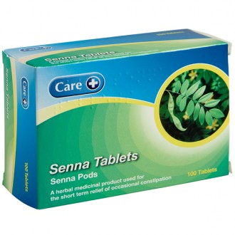
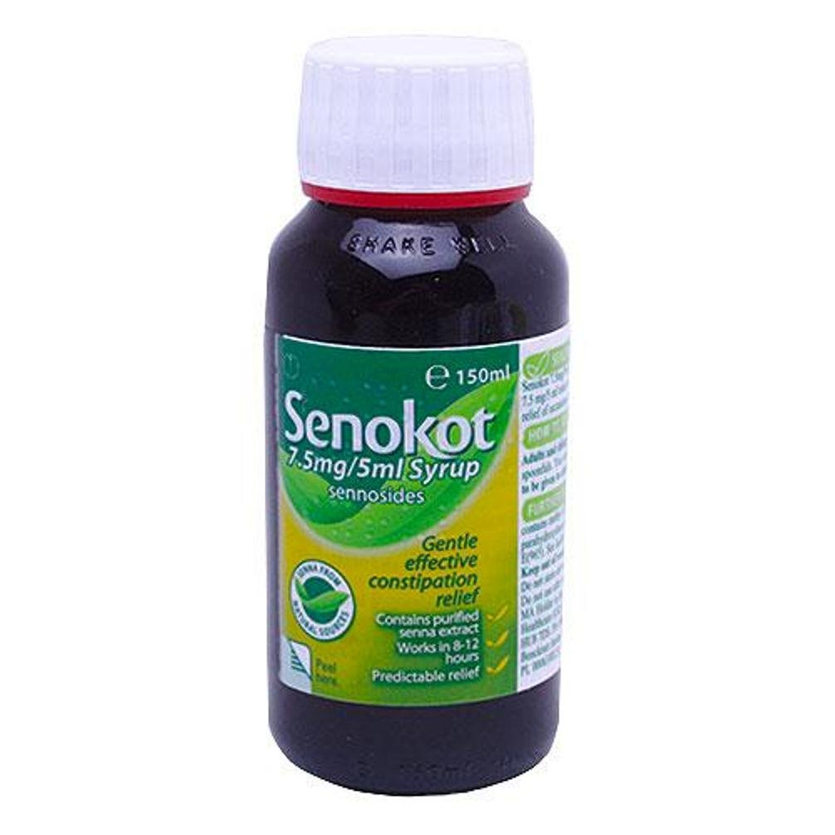
Senna
Clinical condition or situation
Clinical Situation | Occasional constipation
Patients included | All patients with occasional constipation who are not excluded below
Patients Excluded | Patients under the age of 16 years of age Patients who are pregnant or breast-feeding Patients with known allergy/hypersensitivity to senna or its excipients. Cases of intestinal obstructions (e.g. DIOS) and stenosis, atony, appendicitis, inflammatory bowel diseases (e.g. Crohn's disease, ulcerative colitis), abdominal pain of unknown origin, severe dehydration state with water and electrolyte depletion Patients with rare hereditary problems of galactose intolerance, the Lapp lactase deficiency or glucose-galactose malabsorption
Action for patients excluded | Refer to prescriber
Action if patient declines | Refer to prescriber and record in EPR notes

Slide 17
Senna
Description of treatment
Medicine to be administered/supplied | Senna 7.5mg tablet or 7.5mg in 5ml liquid
Dose schedule including maximum dosage | Two tablets or 10ml (15mg)
Maximum number of doses which can be administered under protocol for before review by a prescriber | ONE dose
Follow up/Patient advice | Inform patient of medicine being administered and rationale. If administered monitor patient and use clinical judgement to decide when to seek medical advice.
Record keeping | Doses must be recorded on EPR in the orders section under the title Nurse discretionary medicines Entry made in nursing notes document on EPR.

Slide 18
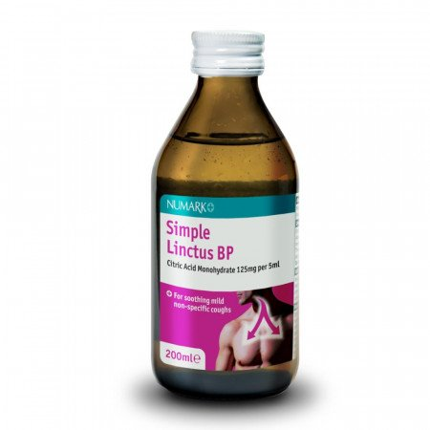
Simple Linctus
Clinical condition or situation
Clinical Situation | Cough
Patients included | All patients with cough who are not excluded below
Patients Excluded | Patients under the age of 16 years of age Patients who are pregnant or breast-feeding Allergy/hypersensitivity to any excipients of Simple Linctus.
Action for patients excluded | Refer to prescriber
Action if patient declines | Refer to prescriber and record in EPR notes

Slide 19
Simple Linctus
Description of treatment
Medicine to be administered/supplied | Simple linctus
Dose schedule including maximum dosage | 5ml up to four times a day
Maximum number of doses which can be administered under protocol for before review by a prescriber | Four doses
Follow up/Patient advice | Inform patient of medicine being administered and rationale. If administered monitor patient and use clinical judgement to decide when to seek medical advice.
Record keeping | Doses must be recorded on EPR in the orders section under the title Nurse discretionary medicines Entry made in nursing notes document on EPR

Slide 20
Nicotine Replacement Therapy Discretionary Medicines

Slide 21

Nicotine Replacements Therapy (NRT)
Nicotine Replacements Therapy
2 Types of NRT
Short Acting - Nicotine absorbed through the buccal membrane (Spray, Inhalator, Gum, Lozenges)
Long Acting – Through the skin (Patches)
21mg, 14mg, 7mg over 24hrs
25mg, 15mg, 10mg over 16hrs
Mechanism of action of Nicotine
Nicotine reduces cravings through binding to nicotinic receptors and this causes dopamine release.

Slide 22
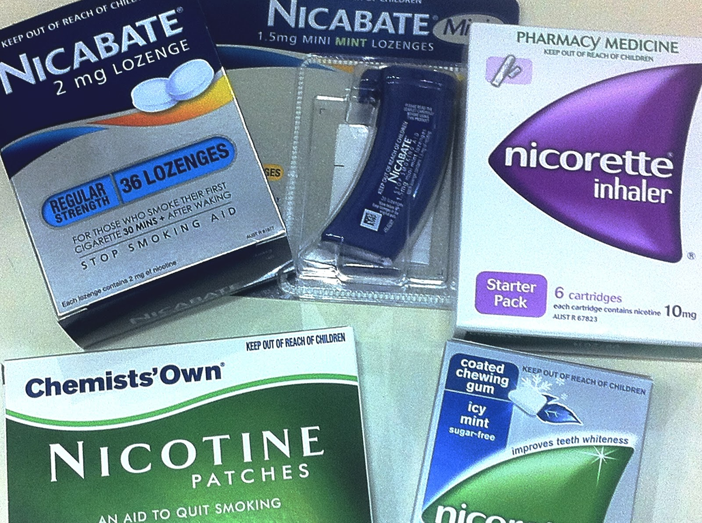
Can we combine NRT Treatments?
Yes- NICE recommends a combination of NRT for all smokers who smoke more than 10 cigarettes per day.
The recommendation is for a Patch + a short acting NRT (such as an inhalator/spray)
More info visit https://www.ncsct.co.uk/usr/pub/Combination%20NRT%202021.pdf
Notes:
Nicotine poisoning

Slide 23
NRT Patches
How do I Know the level of addiction ?
Which NRT Patch should I choose?
Two simple questions to ask :
1.How many cigarettes do you smoke a day? Which Patch should I choose?
<10 = low level addiction – 15mg/16hrs or 14mg/24hrs
10-19 = moderate level addiction -25mg /16hrs or 21mg/24hrs
>20 = High level addiction -25mg /16hrs or 21mg/24hrs
2. How soon after you wake up do you have your first cigarette?
Smoking within 30 minutes of waking = high level of addiction- patient will benefit from a 24hr patch
More info visit https://www.ncsct.co.uk/usr/pub/Combination%20NRT%202021.pdf
Notes:
Nicotine poisoning

Slide 24
NRT Treatment Summary at LHCH
At LHCH we will be using the following NRT via discretionary medicines:
Number of cigarettes per day (CPD) | Type of treatment | Nicotine Replacement Therapy
<10 | Single therapy | Nicotinell TTS 20 14mg/24hour patches
 |  | Nicorette 15mg Inhalator
 |  | Nicotine Quickmist 1mg spray
>10 | Combination | Nicotinell TTS 30 21mg/24hour patches + Nicorette 15mg Inhalator Or Nicotine Quickmist 1mg spray

Slide 25

NRT - Exclusion list
No valid consent
Under 18 years of age.
History of Seizures
Current use of Bupropion (Zyban) or Varenicline (Champix)
Previous allergic reaction to an NRT product
History of uncontrolled psychiatric illness
Unstable Cardiovascular disease
Creatinine Clearance less than 30ml/min
Moderate to severe hepatic impairment
Stroke in the previous 2 weeks
Uncontrolled hyperthyroidism
chronic generalised skin disease (patches only)
Client undergoing treatment for alcohol dependency (Quickmist only due to ethanol content)
History of gastritis, oesophagitis or peptic ulcers (oral therapy only)
Phaeochromocytoma.

Slide 26
NRT- Additional Information
Cautions : insulin treated Diabetes , Gastrointestinal disease , Pregnancy and breastfeeding
Drug Interactions: Smoking cessation may cause alteration to the levels in the patients taking the following drugs. Beta agonists, Beta blockers, Alpha blockers
Oxazepam , Furosemide ,H2 receptor antagonists , Warfarin, Fluvoxamine ,Clomipramine ,Imipramine ,Flecainide ,Pentazocine ,Theophylline ,Cinacalcet,Ropinirole
and Some antipsychotics ( including clozapine, olanzapine, chlorpromazine and haloperidol)
Side effects may include:
With patches: skin reactions –discontinue if severe, vasculitis reported and changes in blood pressure , sleep disturbances, nightmares, chest pain.
With inhalator: hiccups, throat irritation
With oromucosal spray: hiccups, oral symptoms such as burning lips or taste disturbance and gastric upset
Record Keeping :
Doses must be recorded on EPR in the orders section under the title Nurse discretionary medicines & an entry made in the nursing notes

Slide 27
Discretionary Medicines on EPR

Slide 28
How to show on EPR that you have given a medicine under this policy…
It is important that once you have given a dose of a medicine under this policy that you not only record this in the nursing notes on EPR but that you also record the dose on the EPR drug list to show what you have administered.
To do this you need to order the drug via the “nurse discretionary medicines order set” and show that you have administered the dose.
To do this, please follow the steps outlined in the next five slides…
PLEASE NOTE:
ONLY ONCE YOU HAVE COMPLETED THIS TRAINING AND PASSED THE ESR ASSESSMENT WILL YOU HAVE THE PERMISSIONS TO BE ABLE TO ORDER SOMETHING VIA THE “NURSE DISCRETIONARY MEDICINES ORDER SET”

Slide 29
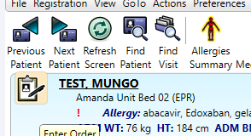
How to show on EPR that you have given a medicine under this policy…
Step 1: When on your patient record on EPR, click on the prescribing icon to request an order

Slide 30
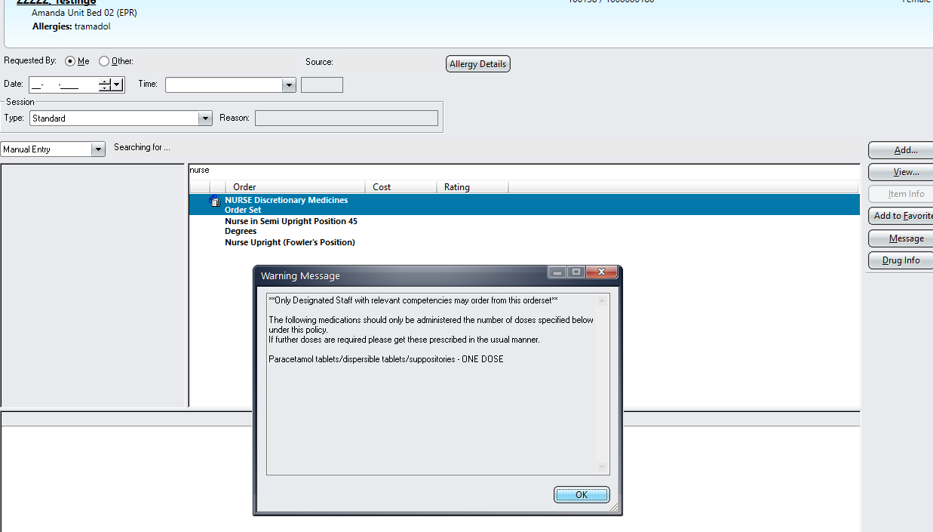
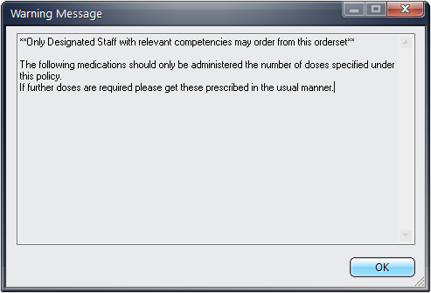
How to show on EPR that you have given a medicine under this policy…
Step 2: Type in “Nurse” and Select the “Nurse Discretionary Medicines Order Set”.
For NRT - Type in “NRT” and select the “Nicotine Replacement Discretionary Medicines Order Set”.
Click “OK” to the warning which is advising that all Discretionary medicines should be ordered under the policy

Slide 31
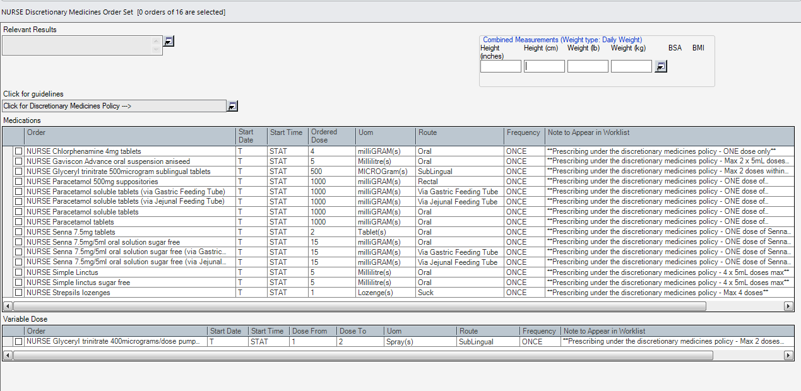
How to show on EPR that you have given a medicine under this policy…
Step 3: Tick the little box next to the item you have given via the policy e.g. Simple Linctus and then click “OK”

Slide 32
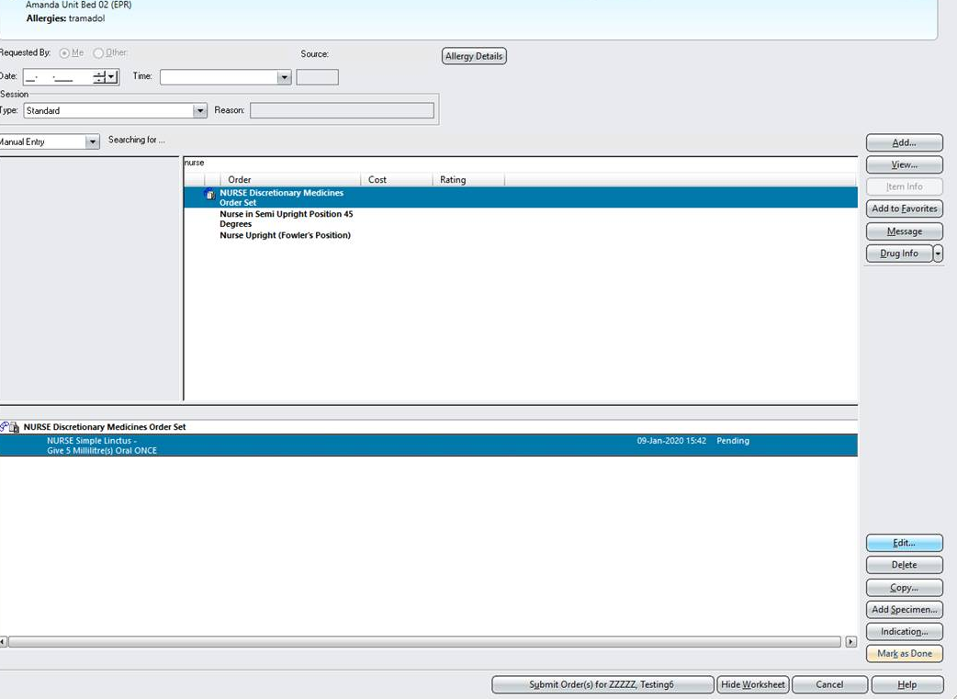
How to show on EPR that you have given a medicine under this policy…
Step 4: Review the order and then click “Submit Order”

Slide 33
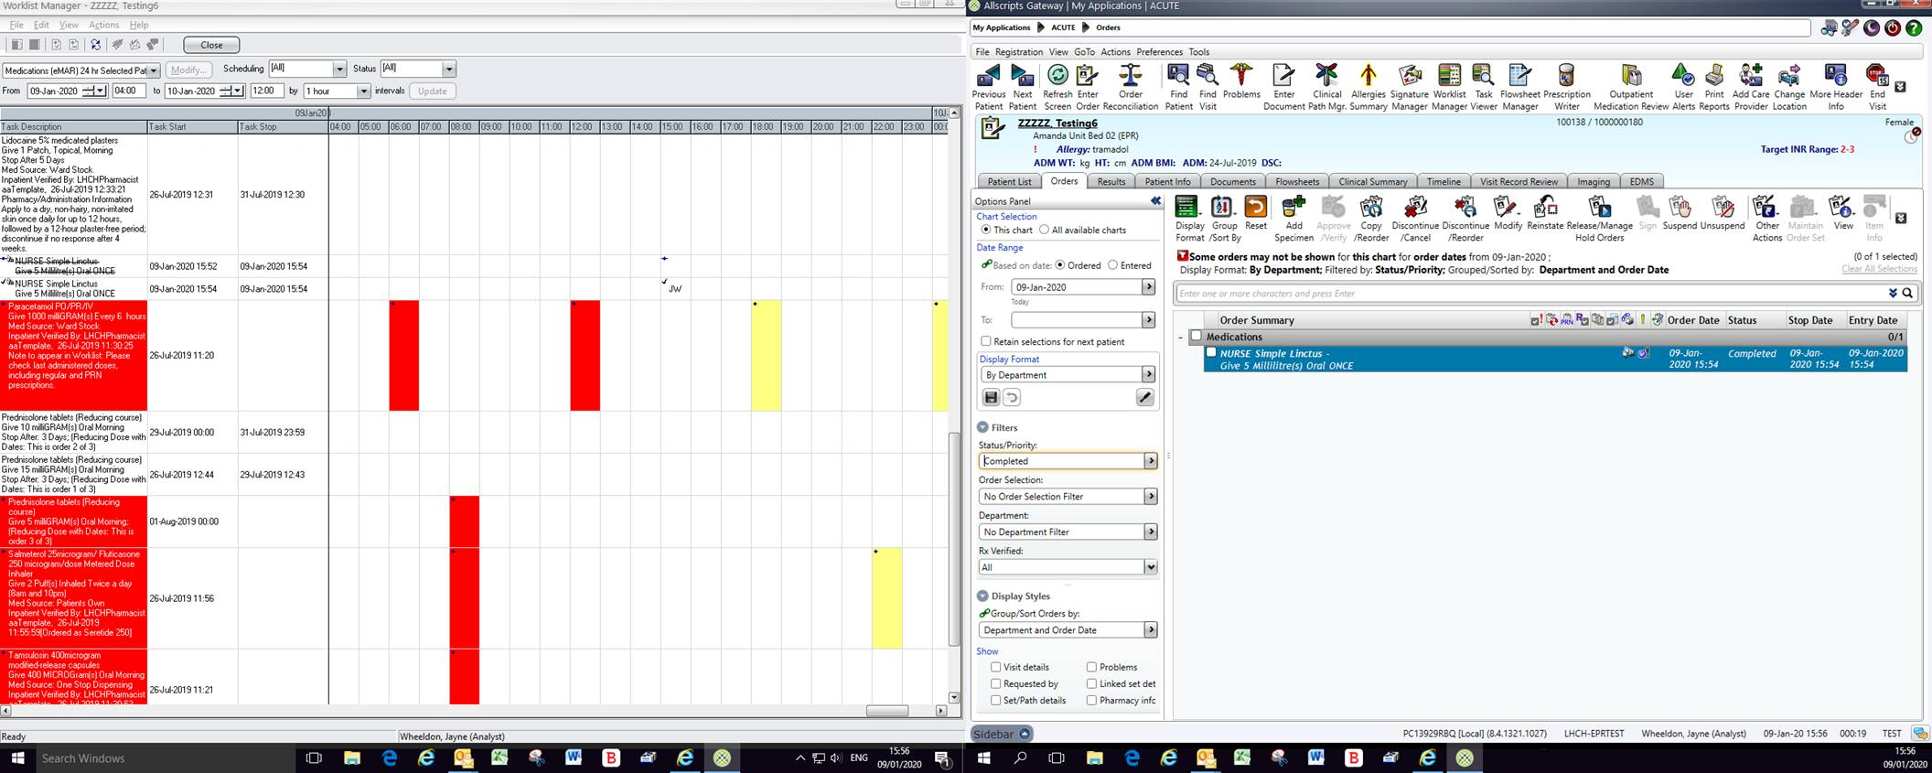
How to show on EPR that you have given a medicine under this policy…
Step 5: Use KBMA to scan the NRT products when administering. Ensure they are signed off on KBMA once given.

Slide 34
Additional Information for Discretionary Medicines

Slide 35
Further Information
The following topical products can be applied without the authorisation of a prescriber:
- Aqueous cream – moisturiser/soap substitute
- Lubricating Jelly – dry lips or nasal passages in patients on Oxygen
- White soft paraffin/yellow soft paraffin for patients with dry/chapped lips not on Oxygen
A record should be made on nursing notes, no record is needed on the medication chart
See the ‘First Dressing Scheme Policy’ for information relating to wound care.
Please read the ‘Administration of Discretionary Medicines Policy’ that is available on the trust intranet.
Please complete the ESR Discretionary Medicines Assessment when you are happy you have read and understood this training.

Slide 36
Further Information
Once you have completed this training you will be granted the rights by EPR to be able to order Discretionary Medicines on the EPR system. These rights will expire after TWO YEARS, so please ensure you renew your training on ESR before the two years is over.

Slide 37
Useful Contacts
If there are any questions relating to this training, the discretionary medicines policy, or NRT then please contact:
Rebecca Renfrew (Lead Pharmacist for PGDs) : 0151 600 1840 Rebecca.Renfrew@lhch.nhs.uk
Pavan Goel (Lead Pharmacist for Education and Training) : 0151 600 1193 Pavan.Goel@lhch.nhs.uk
Djeyapraba Kadar (Smoking Cessation Lead) 0151 600 1052 Djeyapraba.Kadar@lhch.nhs.uk
The Education Centre: 0151 600 1061 theeducationcentre@lhch.nhs.uk
Thank you

